Slide 1
May Allah (swt) guide you
Umut Ergunes 2024

Slide 2
Table of Contents
Intro
Some questions
Religions
Books
Prophets
God
Science in Islam
Facts
FAQ

Slide 3
Intro
This powerpoint has been created to give you an insight into what religion is. No compulsion or obligation to join a religion or do things is given here.
As said in the Qur'an:
‘Let there be no compulsion in religion, for the truth stands out clearly from falsehood’ - Surah Al-Baqarah (2:256)
Those who are interested and want to understand the truth and why we live, can hopefully learn from this powerpoint.
This powerpoint will highlight Islam's view of the world and the afterlife
"For believers, one proof suffices; for non-believers, even countless proofs won't be seen by the heart."

Slide 4
List of Abbreviations
cc (Celle Celaluhu) (in Turkish) | The Mighty and The Majestic
swt (Subhanahu wa ta'ala) (in Arabic) | The most glorified, the most high
Hz. (Hazrat) (in Arabic) | "Hz. Adem" translates to "The Honorable Adam"
saw (Sallallahu Alayhi Wasallam) (in Arabic) | Peace and blessings be upon him
as (Alayhis Salam) (in Arabic) | Peace be upon him
ra (Radi Allahu Anhu/Anha) (in Arabic) | May Allah be pleased with him/her

Slide 5
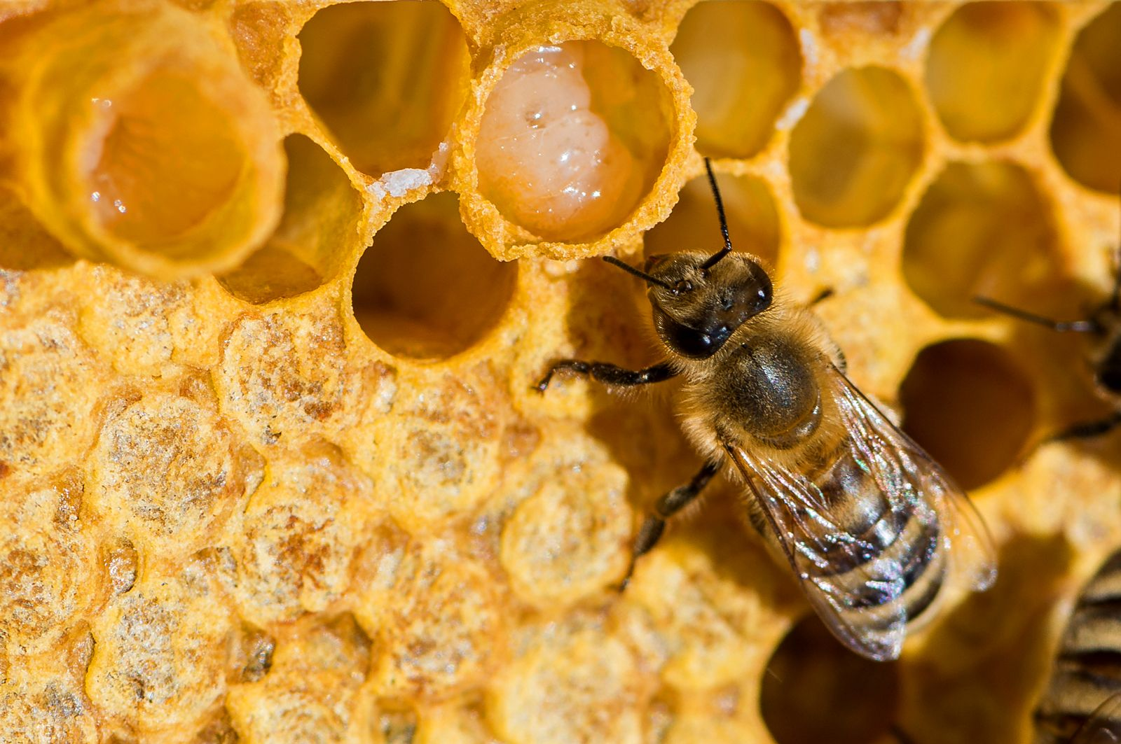
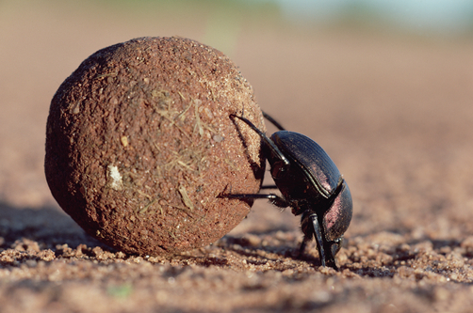
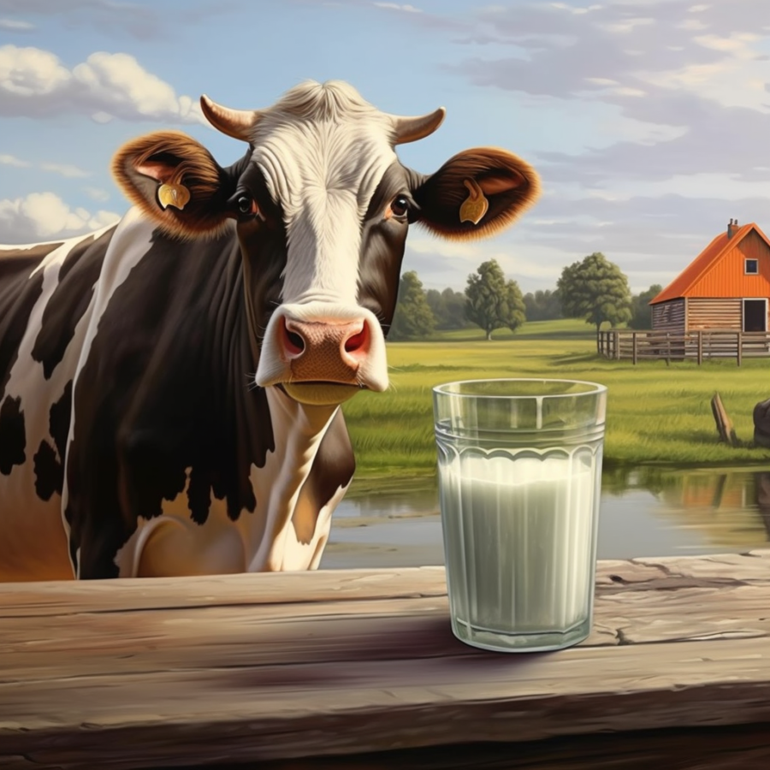

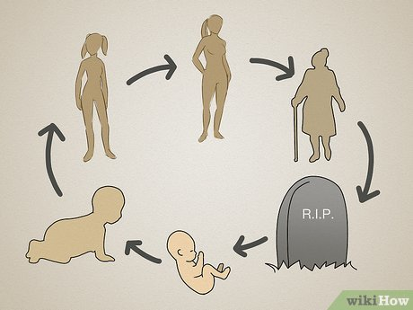
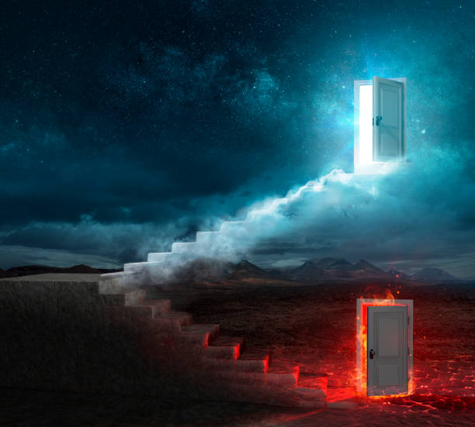

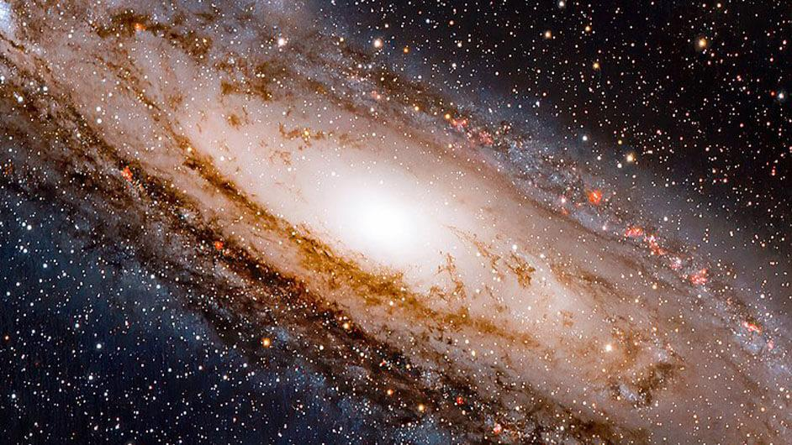
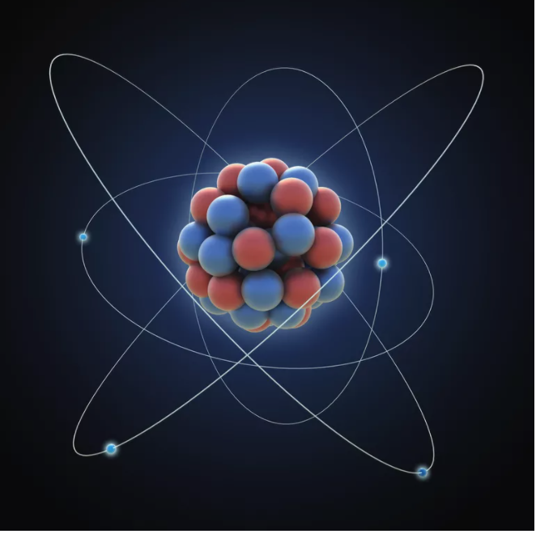
Some questions
Purpose of life?
After life?
Morality?
Universe & Atoms?

Slide 6
Religions
Monotheïsme (One single God)
Polytheïsme (Multiple Gods)
Judaism
Christianity
Islam
Sikhism (Indian)
Zoroastrianism (Persian)
Etc.
Hinduism
Ancient Greek Religion
Norse Mythology
Shinto (Japan)
Ancient Egyptian Religion
Etc.

Slide 7
Islam (Submission) Muslim (one who submits)
Core beliefs:
Afterlife:
Belief in Allah: The one and only God.
Belief in Angels: Spiritual beings who serve God.
Belief in the Holy Books: Including the Qur'an, Torah, Psalms, and Gospel.
Belief in the Prophets: Messengers sent by God, including Adam, Moses, Jesus, and Muhammad.
Belief in the Day of Judgment: The day when all individuals will be resurrected and judged by God.
Belief in Predestination: God's knowledge and control over all that happens (divine decree).
Day of Judgment: All humans will be resurrected and judged by God.
Heaven (Jannah): Eternal paradise for the righteous.
Hell (Jahannam): Place of punishment for the wicked.
Expectations:
Ethical Conduct: Honesty, compassion, and justice.
Dietary Laws: Halal food, prohibition of alcohol and pork.
Modesty: Dress code.
Community: Importance of family and community bonds.
Continual Learning: Seeking knowledge is highly valued.
Obligations (The Five Pillars):
Shahada: Declaration of faith.
Salah: Performing five daily prayers.
Zakat: Giving alms to the needy.
Sawm: Fasting during the month of Ramadan.
Hajj: Pilgrimage to Mecca at least once in a lifetime, if able.

Slide 8
Christianity(the anointed one) Christ (follower of christ)
Core beliefs:
Afterlife:
Belief in God: One God in three persons (Trinity) - Father, Son (Jesus Christ), and Holy Spirit.
Jesus Christ: Central figure, believed to be the Son of God and the Savior of humanity.
Holy Bible: The sacred scripture, consisting of the Old Testament and New Testament.
Salvation: Belief in salvation through faith in Jesus Christ.
Resurrection: Belief in the resurrection of Jesus and the eventual resurrection of all believers.
Second Coming: Belief in the return of Jesus Christ to judge the living and the dead.
Heaven: Eternal life with God for those who have faith in Jesus.
Hell: Eternal separation from God for those who reject faith in Jesus.
Judgment Day: The final judgment where everyone is judged by their faith and actions.
Expectations:
Moral Conduct: Living according to the teachings of Jesus, including love, honesty, and humility.
Evangelism: Sharing the message of Jesus with others.
Community: Participating in and supporting the Christian community.
Forgiveness: Practicing forgiveness as taught by Jesus.
Personal Relationship with God: Developing a personal and direct relationship with God through faith and prayer.
Obligations (The Five Pillars):
Prayer: Regular communication with God.
Worship: Gathering for communal worship, often on Sundays.
Sacraments: Rituals such as Baptism and Eucharist (Communion).
Reading Scripture: Studying the Bible.
Charity: Helping those in need, practicing love and compassion.

Slide 9
Judaism (Yehudah = the twelve tribes of Israel) Jew (follower of Judaism)
Core beliefs:
Afterlife:
Monotheism: Belief in one God, Yahweh.
Covenant: The special relationship between God and the Jewish people.
Torah: The foundational text of Judaism, containing God's laws and commandments.
Prophets: Belief in the teachings and guidance of prophets like Moses.
Olam Ha-Ba: The world to come, a spiritual afterlife.
Resurrection: Some Jews believe in the resurrection of the dead during the Messianic age.
Judgment: Souls are judged by God, but the specifics of the afterlife vary within Judaism.
Obligations (The Five Pillars):
Expectations:
Prayer: Regular prayers, including three daily prayers.
Sabbath (Shabbat): Weekly day of rest and worship from Friday evening to Saturday evening.
Dietary Laws (Kashrut): Keeping kosher, adhering to specific dietary restrictions.
Mitzvot: Performing commandments and good deeds as prescribed in the Torah.
Ethical Conduct: Living a life of justice, kindness, and humility.
Community: Participating in and supporting the Jewish community.
Study: Continuous study of the Torah and other sacred texts.
Tradition: Observing Jewish holidays, rituals, and customs.

Slide 10
Books
Qur'an (Islam)
Bible (Christianity)
Tanakh (Judaism)
Guru Granth Sahib (Sikhism)
Vedas (Hinduism)
Tripitaka (Pali Canon) (Buddhism)
Avesta (Zoroastrianism)
Kojiki and Nihon Shoki (Shinto)
The Iliad and The Odyssey (Ancient Greek Religion)
Poetic Edda and Prose Edda (Norse Mythology)
Pyramid Texts and the Book of the Dead (Ancient Egyptian Religion)

Slide 11
Qur'an (Guidance book for humanity)
Quantity: One Single Book
Revelation language: Arabic.
Revelation: Revealed to Prophet Muhammad (saw) by the angel Gabriel over 23 years.
Structure: 114 chapters (Surahs).
Preservation Methods:
Oral Tradition (memorization by Muslims, Hafiz)
Written Record (Topkapi & Birmingham manuscript --> Radiocarbon test resulst: 568 and 645 AD with 95.4% accuracy)
Recurrent Recitation (Daily prayer)
Content Themes:
Monotheism: Belief in one God, Allah.
Prophethood: Stories and teachings of prophets.
Afterlife: Descriptions of Heaven (Jannah) and Hell (Jahannam).
Law and Morality: Guidelines for ethical and legal conduct.
Faith and Worship: Instructions on prayers, fasting, charity, etc.
Qur'an Miracles:
Unique
No logic error
Talking about the future
Came to an illiterate prophet
Universal
Scientific signs
Literary superiority, eloquence
Suitable for the mind and heart
Appealing to all human characteristics

Slide 12
Bible (Anthology)
Quantity: Compilation of different books (66 in Protestant, 73 in Catholic, additional texts in Orthodox).
Revelation Languages: Primarily Hebrew (Old Testament) and Greek (New Testament); some portions in Aramaic (e.g., parts of Daniel and Ezra).
Revelation: Believed to be inspired by God, written by various prophets and apostles over centuries.
Structure: Old Testament (39 books in Protestant, more in Catholic and Orthodox) and New Testament (27 books).
The Bible has undergone numerous translations and revisions, which have sometimes introduced variations.
Content Themes:
Monotheism: Belief in one God, expressed in the Trinity.
Prophethood: Stories and teachings of prophets like Moses, Isaiah, and John the Baptist.
Salvation: Belief in salvation through Jesus Christ.
Law and Morality: Ten Commandments, Sermon on the Mount.
Faith and Worship: Instructions on prayer, sacraments, love, and charity.

Slide 13
Prophets
Islam: Muhammad (saw) is regarded as the last prophet (Seal of the Prophets).
Christianity: Jesus Christ is considered the central figure and the last prophet.
Judaism: Malachi is often considered the last of the prophets in the Hebrew Bible.
Bahá'í Faith: Bahá'u'lláh is considered the latest prophet and the founder of the Bahá'í Faith.
Druze: Al-Hakim bi-Amr is considered the last prophet in the Druze faith.
Hinduism: Krishna and Rama are highly revered.
Ancient Greek Religion: Oracle of Delphi were highly significant.
Ancient Egyptian Religion: Osiris and Anubis were central to their mythology.

Slide 14
Muhammed (saw)
Prophet Muhammad (saw) was born around 571 CE in Mecca
His father, Abdullah, died before he was born, and his mother, Amina, passed away when he was six years old.
In his youth, Muhammad (saw) worked as a shepherd, a common job for young boys in Mecca.
Prophet Muhammad (saw) was known for his illiteracy; he could neither read nor write.
Prophet worked as a merchant and had earned a reputation for his honesty. They called him "Al-Ameen" (The Trustworthy)
Prophet Muhammad (saw) married Khadijah, a wealthy widow, when he was 25 years old.
At the age of 40, Prophet Muhammad (saw) received his first revelation from the archangel Gabriel in the cave of Hira.
Prophet Muhammad (saw) passed away on 632-633 CE in Medina
Prophet Muhammad (saw) brought the words of Allah (cc) to all of humanity
While other prophets:
Prophet Noah (Nuh) (AS): Sent to the people of Mesopotamia (modern-day Iraq).
Prophet Abraham (Ibrahim) (AS): Sent to the people of Mesopotamia (modern-day Iraq) and Canaan (modern-day Israel/Palestine).
Prophet Moses (Musa) (AS): Sent to the Israelites in Egypt.
Prophet Jesus (Isa) (AS): Sent to the Israelites in Palestine.
Prophet Hud (AS): Sent to the people of Ad (modern-day Yemen).
Prophet Salih (AS): Sent to the people of Thamud (modern-day Saudi Arabia).
Prophet Lot (Lut) (AS): Sent to the people of Sodom and Gomorrah (modern-day Jordan and Israel).
Prophet Jonah (Yunus) (AS): Sent to the people of Nineveh (modern-day Iraq).

Slide 15
God
Islam:
Muslims believe in one God, Allah (swt), who is all-powerful and all-knowing. Allah is indivisible and has no partners or equals.
Christianity:
Christians believe in one God who exists in three persons (Trinity): Father, Son (Jesus Christ), and Holy Spirit. God is seen as omnipotent, omniscient, and omnipresent.
Judaism:
Jews believe in a single, indivisible God named Yahweh. God is transcendent and immanent, involved in the world but beyond human comprehension.

Slide 16
Allah (swt)
Allah (cc) is the One and only God in Islam, the creator of the universe and everything within it.
Creation Requires Knowledge and Ability: To create something as complex as an atom, immense knowledge and ability are required. Just as a scientist must understand atomic structure to create or manipulate atoms, Allah's creation of the universe demonstrates His ultimate knowledge and power.
Atom: Creating an atom requires understanding subatomic particles and forces. Allah's creation of the universe reflects His unparalleled knowledge.
Human Body: The intricate design of the human body, from DNA to organs, showcases Allah’s extraordinary capability as the Creator.
Ecosystem: The balance and interdependence of living organisms in ecosystems demonstrate Allah’s wisdom and meticulous planning.
Table and Carpenter: Just as a carpenter creates a table, Allah (cc) creates the universe. The carpenter designs, shapes, and constructs the table, but he doesn't resemble the table in any way. He is distinct from his creation and possesses different attributes and abilities.

Slide 17
Allah (swt)
Allah (cc) has 99 Names: each representing a different attribute or quality of Allah (cc).
Examples:
Al-‘Aleem (The All-Knowing): Allah possesses complete and infinite knowledge of everything in the universe, including the past, present, and future. Humans have limited knowledge and understanding.
Al-Qadir (The All-Powerful): Allah has absolute power over all things and can do whatever He wills. Humans have limited power and capability.
Al-Khaliq (The Creator): Allah is the originator and creator of everything in existence. Humans can create and invent, but they cannot create life from nothing.
Al-Hayy (The Ever-Living): Allah is eternal and His existence is without beginning or end. Human life is finite and limited to a certain lifespan.
As-Samad (The Absolute): Allah is self-sufficient and independent, needing nothing from anyone. Humans, on the other hand, are dependent on Allah (cc) and each other for various needs.

Slide 18
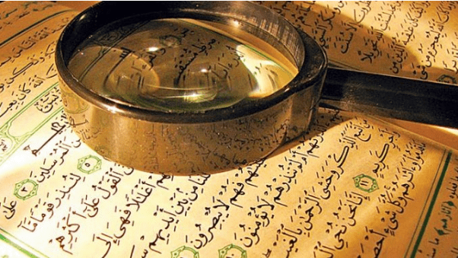
Science in Islam
Origin of iron
Expansion of univers
Plate Tectonics
Pulsar Stars
Human development & embryology
Rome war
Pyramids
Astronauts trainings before going in space
Female worker honey bees
Living beings contain a significant amount of water

Slide 19
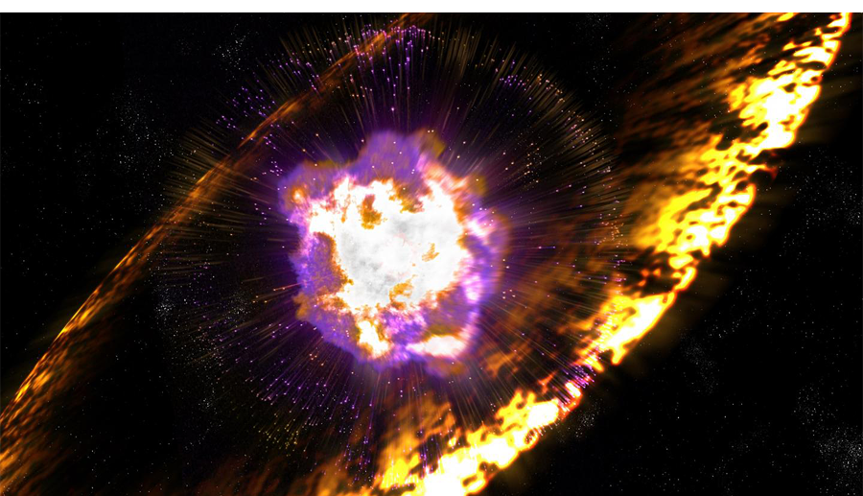
Science in Islam
Origin of iron
In 1856, Lord Kelvin presented a paper to the Royal Society of London, suggesting that meteorites were the source of iron found in ancient artifacts.
Qur'an: Surah Al-Hadid (57:25)
“And We sent down iron, wherein is great military might and benefits for the people.”
https://www.sciencing.com/origin-iron-5371252/#:~:text=By%20scientific%20standards%2C%20the%20origin,atom%20a%20star%20can%20produce.
https://www.atlasobscura.com/articles/before-iron-age-most-iron-came-from-space-meteorite-egyptian-bronze

Slide 20
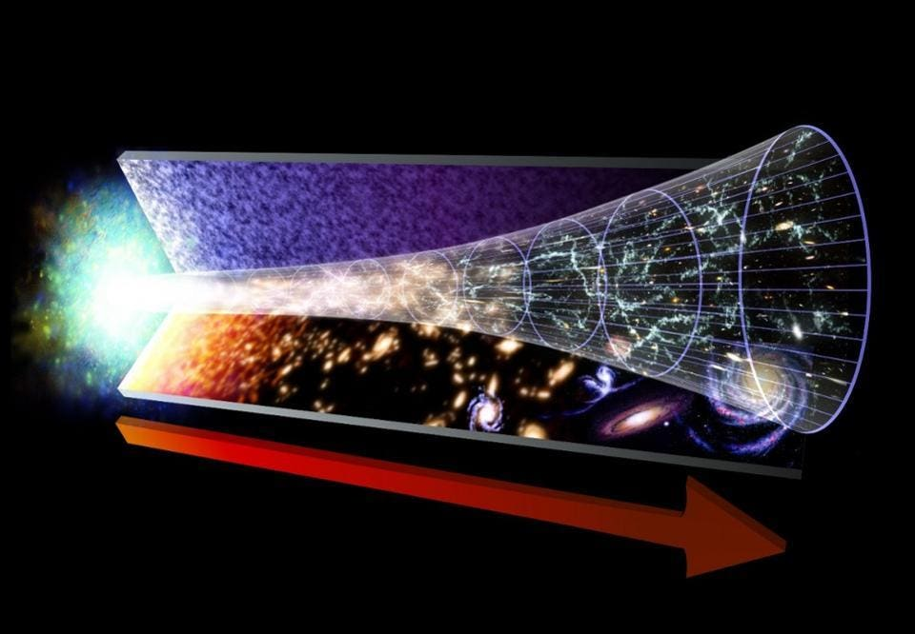
Science in Islam
Expansion of univers
In 1924, Knut Lundmark observed galaxies visible from the Milky Way were all moving away from us, revealing the very expansion of the universe itself
Qur'an: Surah Adh-Dhariyat (51:47)
“And the heaven We constructed with strength, and indeed, We are [its] expander.”
livescience.com
en.wikipedia.org
jpl.nasa.gov
cas.sdss.org

Slide 21
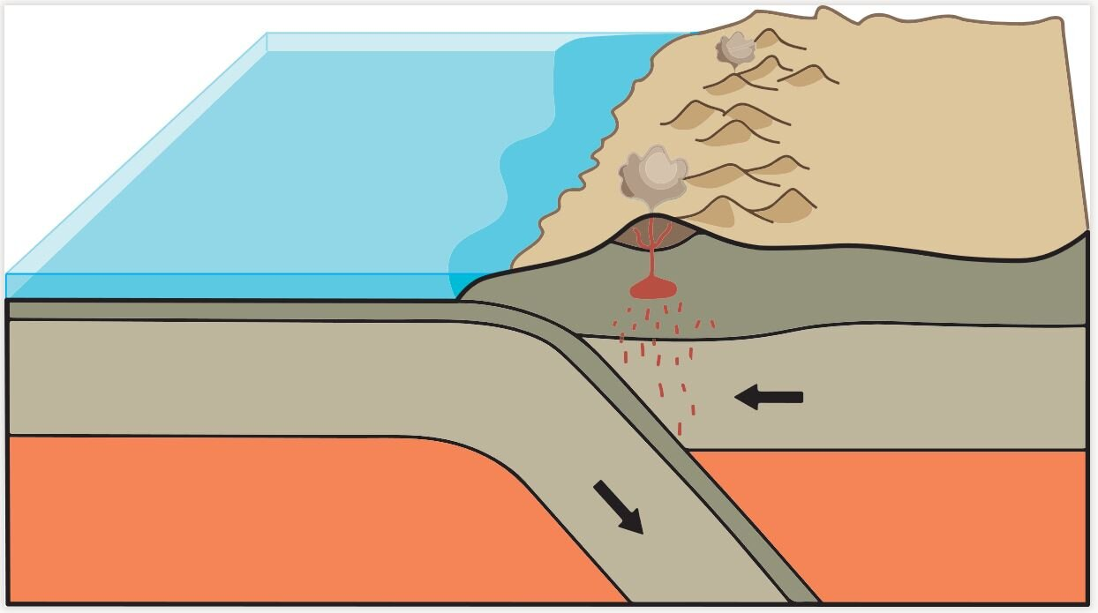
Science in Islam
Plate Tectonics:
Plate Tectonics: The theory of plate tectonics was developed and supported by numerous scientists and organizations over the years. Key contributors include:
Alfred Wegener: Proposed the theory of continental drift in 1912.
Harry Hess: Proposed the seafloor spreading hypothesis in the 1960s.
US Geological Survey (USGS): Provided extensive research and data supporting plate tectonics.
Harvard University: Researchers provided stronger proof of plate tectonics billions of years ago.
In Surah Al-Naml (27:88): "And you will see the mountains and think them solid, but they shall pass away as the passing away of the clouds. The Work of Allah, Who perfected all things, verily! He is Well-Acquainted with what you do."
Sources:
https://education. nationalgeographic.org/ resource/continental-drift/
https://www.geolsoc.org.uk/ Plate-Tectonics/ Chap1-Pioneers-of -Plate-Tectonics/ Alfred-Wegener

Slide 22
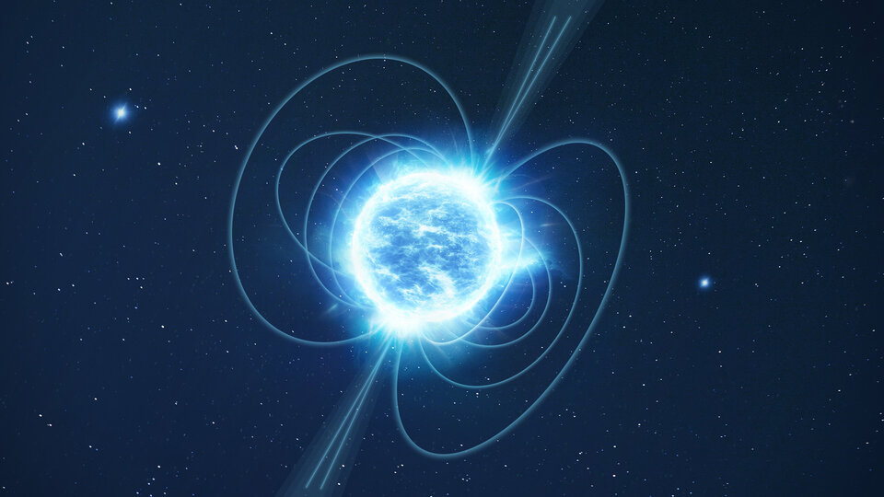
Science in Islam
Pulsar Stars:
Pulsar Stars: The discovery and study of pulsar stars have been significantly contributed by:
Jocelyn Bell Burnell and Antony Hewish: Discovered the first pulsar in 1967.
Russell Alan Hulse and Joseph Hooton Taylor Jr.: Discovered the Hulse-Taylor binary pulsar in 1974, which provided evidence for gravitational waves.
NASA and ESA: Have conducted extensive research and observations on pulsars, including the Crab Pulsar
In Surah At-Tariq (86:1-3): "1.By the heaven, and At-Tariq (the night-comer, i.e. the bright star); 2. And what will make you to know what At-Tariq (night-comer) is? 3. (It is) the star of piercing brightness" Meaning of "Tariq": In Arabic, the word "Tariq" means coming at night, striking or hitting (sound of pulsar stars are similar like hitting a door). The description of this star in the Quran as "piercing" (النجم الثاقب, necm-i sâkıb) has been likened by some commentators to the characteristics of modern pulsars. Pulsars are neutron stars that form after supernova explosions and emit regular and powerful radio waves. These waves have a piercing effect.
Sources
https://www.cam.ac.uk/ stories/ journeysofdiscovery-pulsars
https://www.frontiersin.org/ news/2022/09/22/ children-in-science -jocelyn-bell-burnell -discovered-pulsars/

Slide 23
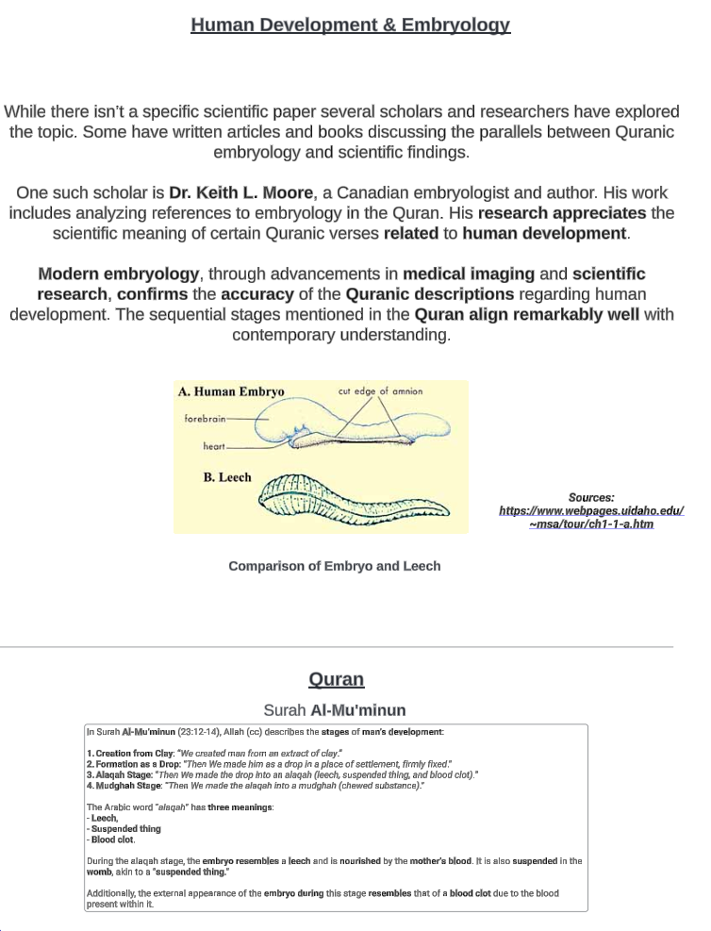
Science in Islam
Human development & embryology

Slide 24
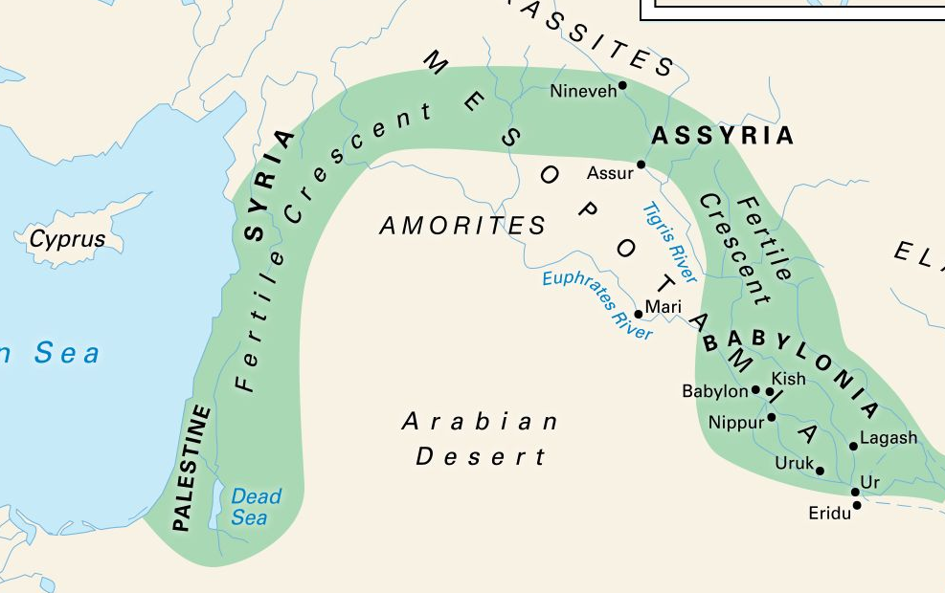
Rome war
Eastern Roman Empire: The Byzantine Empire, also referred to as the Eastern Roman Empire, was the continuation of the Roman Empire centred in Constantinople during late antiquity and the Middle Ages.
The Sasanian Empire: was the last pre-Islamic Persian empire
The Defeat: Around 613–614 CE, the Byzantines suffered significant losses to the Sassanids. Key defeats include:
The Battle of Antioch (613 CE): A major Byzantine loss.
The Fall of Jerusalem (614 CE): The Persians captured Jerusalem, a significant blow to Byzantine morale and power.
The Victory Within "Three to Nine Years":
Byzantine Emperor Heraclius launched a series of counter-offensives starting in 622 CE.
By 627 CE, the Byzantines achieved a decisive victory over the Persians at the Battle of Nineveh, effectively turning the tide of the war.
Dead Sea: At 410m below sea level, the Dead Sea is the lowest place on earth.
Qur'an: "The Romans have been defeated. In the nearest land. But they, after their defeat, will overcome. Within three to nine years..."
The verses in Surah Ar-Rum (30:2-4) were revealed during the early Meccan period of Prophet Muhammad's mission, likely around 615-616 CE. At that time, the Byzantine (Roman) Empire had already suffered a major defeat to the Sassanid Persian Empire
https://www.thecollector.com/what-is-the-last-great-war-of-antiquity/

Slide 25
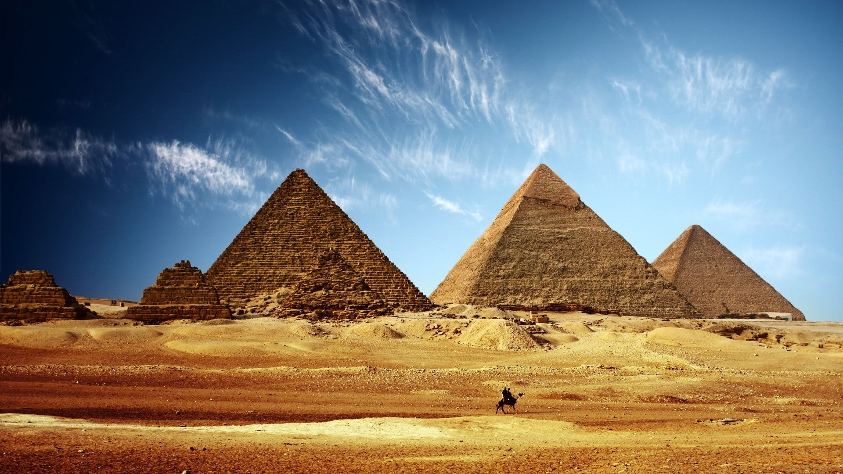
Pyramids (Don't have a clear scientific proof yet)
Joseph Davidovits 1988 Theory:
Modern theories by scientists like Joseph Davidovits suggest parts of the pyramids may have been built using geopolymer (man-made stone from heated clay and other materials).
Microscopic studies reveal pyramid stones may include cast materials resembling natural limestone.
https://www.youtube.com/watch?v=znQk_yBHre4&ab_channel=GeopolymerInstitute
Qur'an:
''And Pharaoh said, 'O nobles, I do not know that you have any god beside myself. Haman, bake bricks out of clay and build a lofty palace for me so that I may mount up and be able to observe the god of Moses, even though I believe that Moses is a liar.'"
Joseph Davidovits and Margie Morris (The Pyramids: An Enigma Solved, 1988)

Slide 26

Astronauts trainings before going in space?
This training takes place in the Neutral Buoyancy Laboratory (NBL), a large indoor pool that contains mock-ups of spacecraft and space station modules.
Simulate Microgravity: The underwater environment allows astronauts to experience a similar sensation to what they will feel in the microgravity of space
Prepare for Spacewalks: Astronauts practice intricate tasks such as repairing equipment, installing new modules, and conducting scientific experiments.
https://www.youtube.com/watch?v=4514z--Zbfk&t=133s&ab_channel=BlueWorldTV
Surah Al-Anbiya (21:33):
"And it is He who created the night and the day and the sun and the moon; all [heavenly bodies] in an orbit are swimming."
Neutral Buoyancy Training

Slide 27
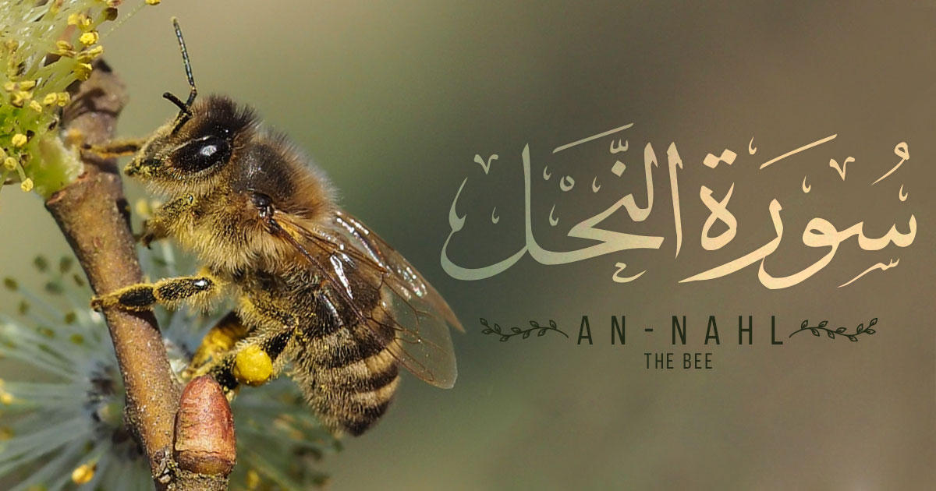
Female worker honey bees?
Between 500-650 AD, There wasn't any scientific proof regarding the genders of honey bees.
The understanding of bee biology and gender roles was very limited during that time.
The concept that worker bees were female and drones were male wasn't scientifically established until much later.
It wasn't until the mid-1800s that Johann Dzierzon,
a Catholic priest, discovered the unique sex determination system in honey bees, where fertilized eggs become females (workers or queens) and unfertilized eggs become males (drones).
A non-Muslim beekeeper (McKay Orton) interprets the verses about bees in the Quran:
https://www.youtube.com/watch?v=VDAoGww1GTk&t=76s&ab_channel=QuranicPerspectives
Surah An-Nahl (16:68-69)
The verse uses the feminine form when describing the actions of bees, such as building their hives and producing honey. The Arabic word for bee, "an-nahl", is conjugated in the feminine form

Slide 28
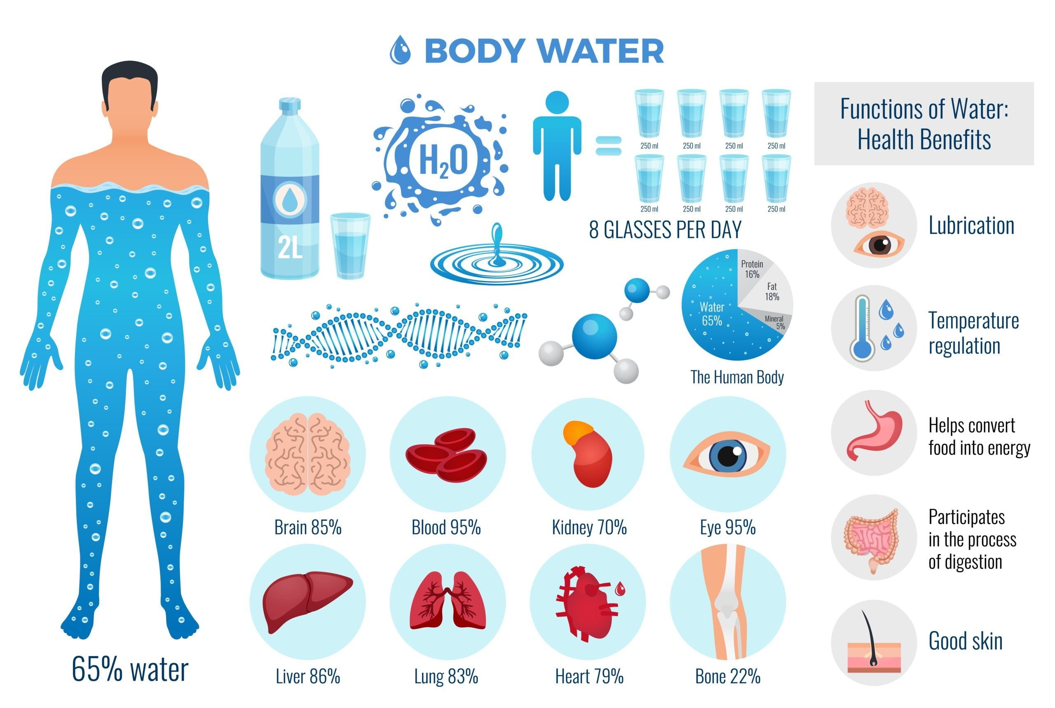
Living beings contain a significant amount of water?
The scientific understanding that the human body and other living beings contain a significant amount of water has evolved over centuries. Antoine Lavoisier, a French chemist and biologist in the late 18th and early 19th centuries, is credited with discovering that the human body is primarily made of water, with an approximate percentage of 70%.
Surah An-Nur (24:45):
"Allah has created every [living] creature from water. And of them are those that move on their bellies, and of them are those that walk on two legs, and of them are those that walk on four. Allah creates what He wills. Indeed, Allah is over all things competent."

Slide 29
Facts
Possibility of the creation of the universe
The space we occupy in the entire universe
Unique Tastes and Functions of Fluids in the Human Head
Atoms and Consciousness
DNA
Big-Bang
Discovering the art does not prove that the artist does not exist
Looking for Higher Power
Corruption of the Bible
Jesus was not a God
Muhammed (saw) existed in history
Islam is absolutely the right way and the religion of truth

Slide 30
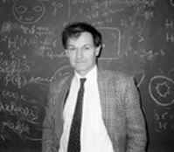
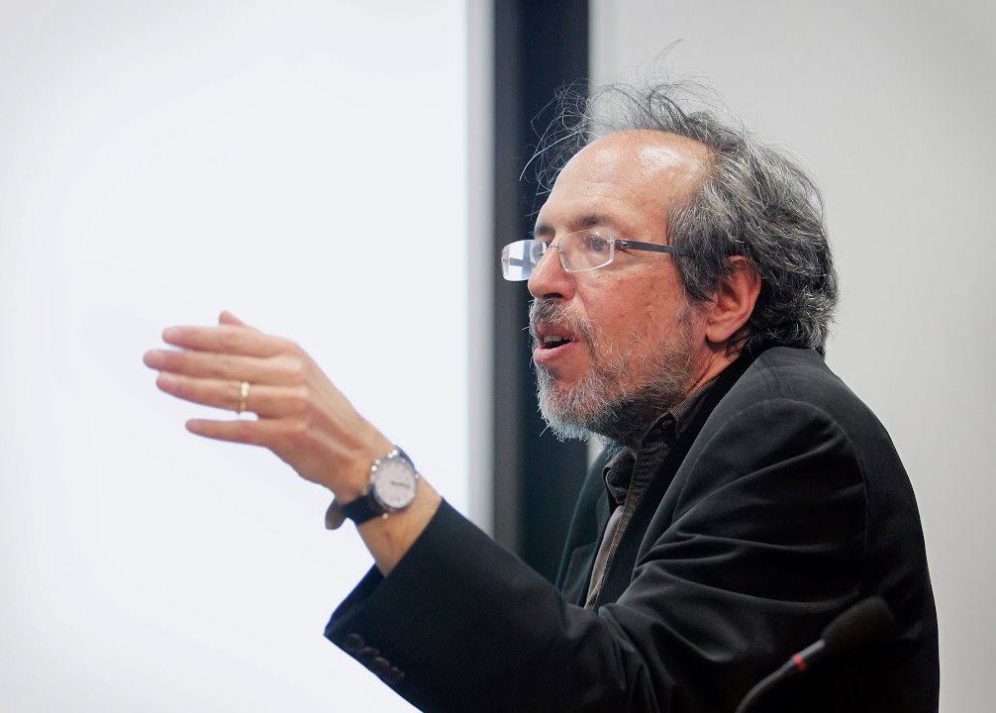
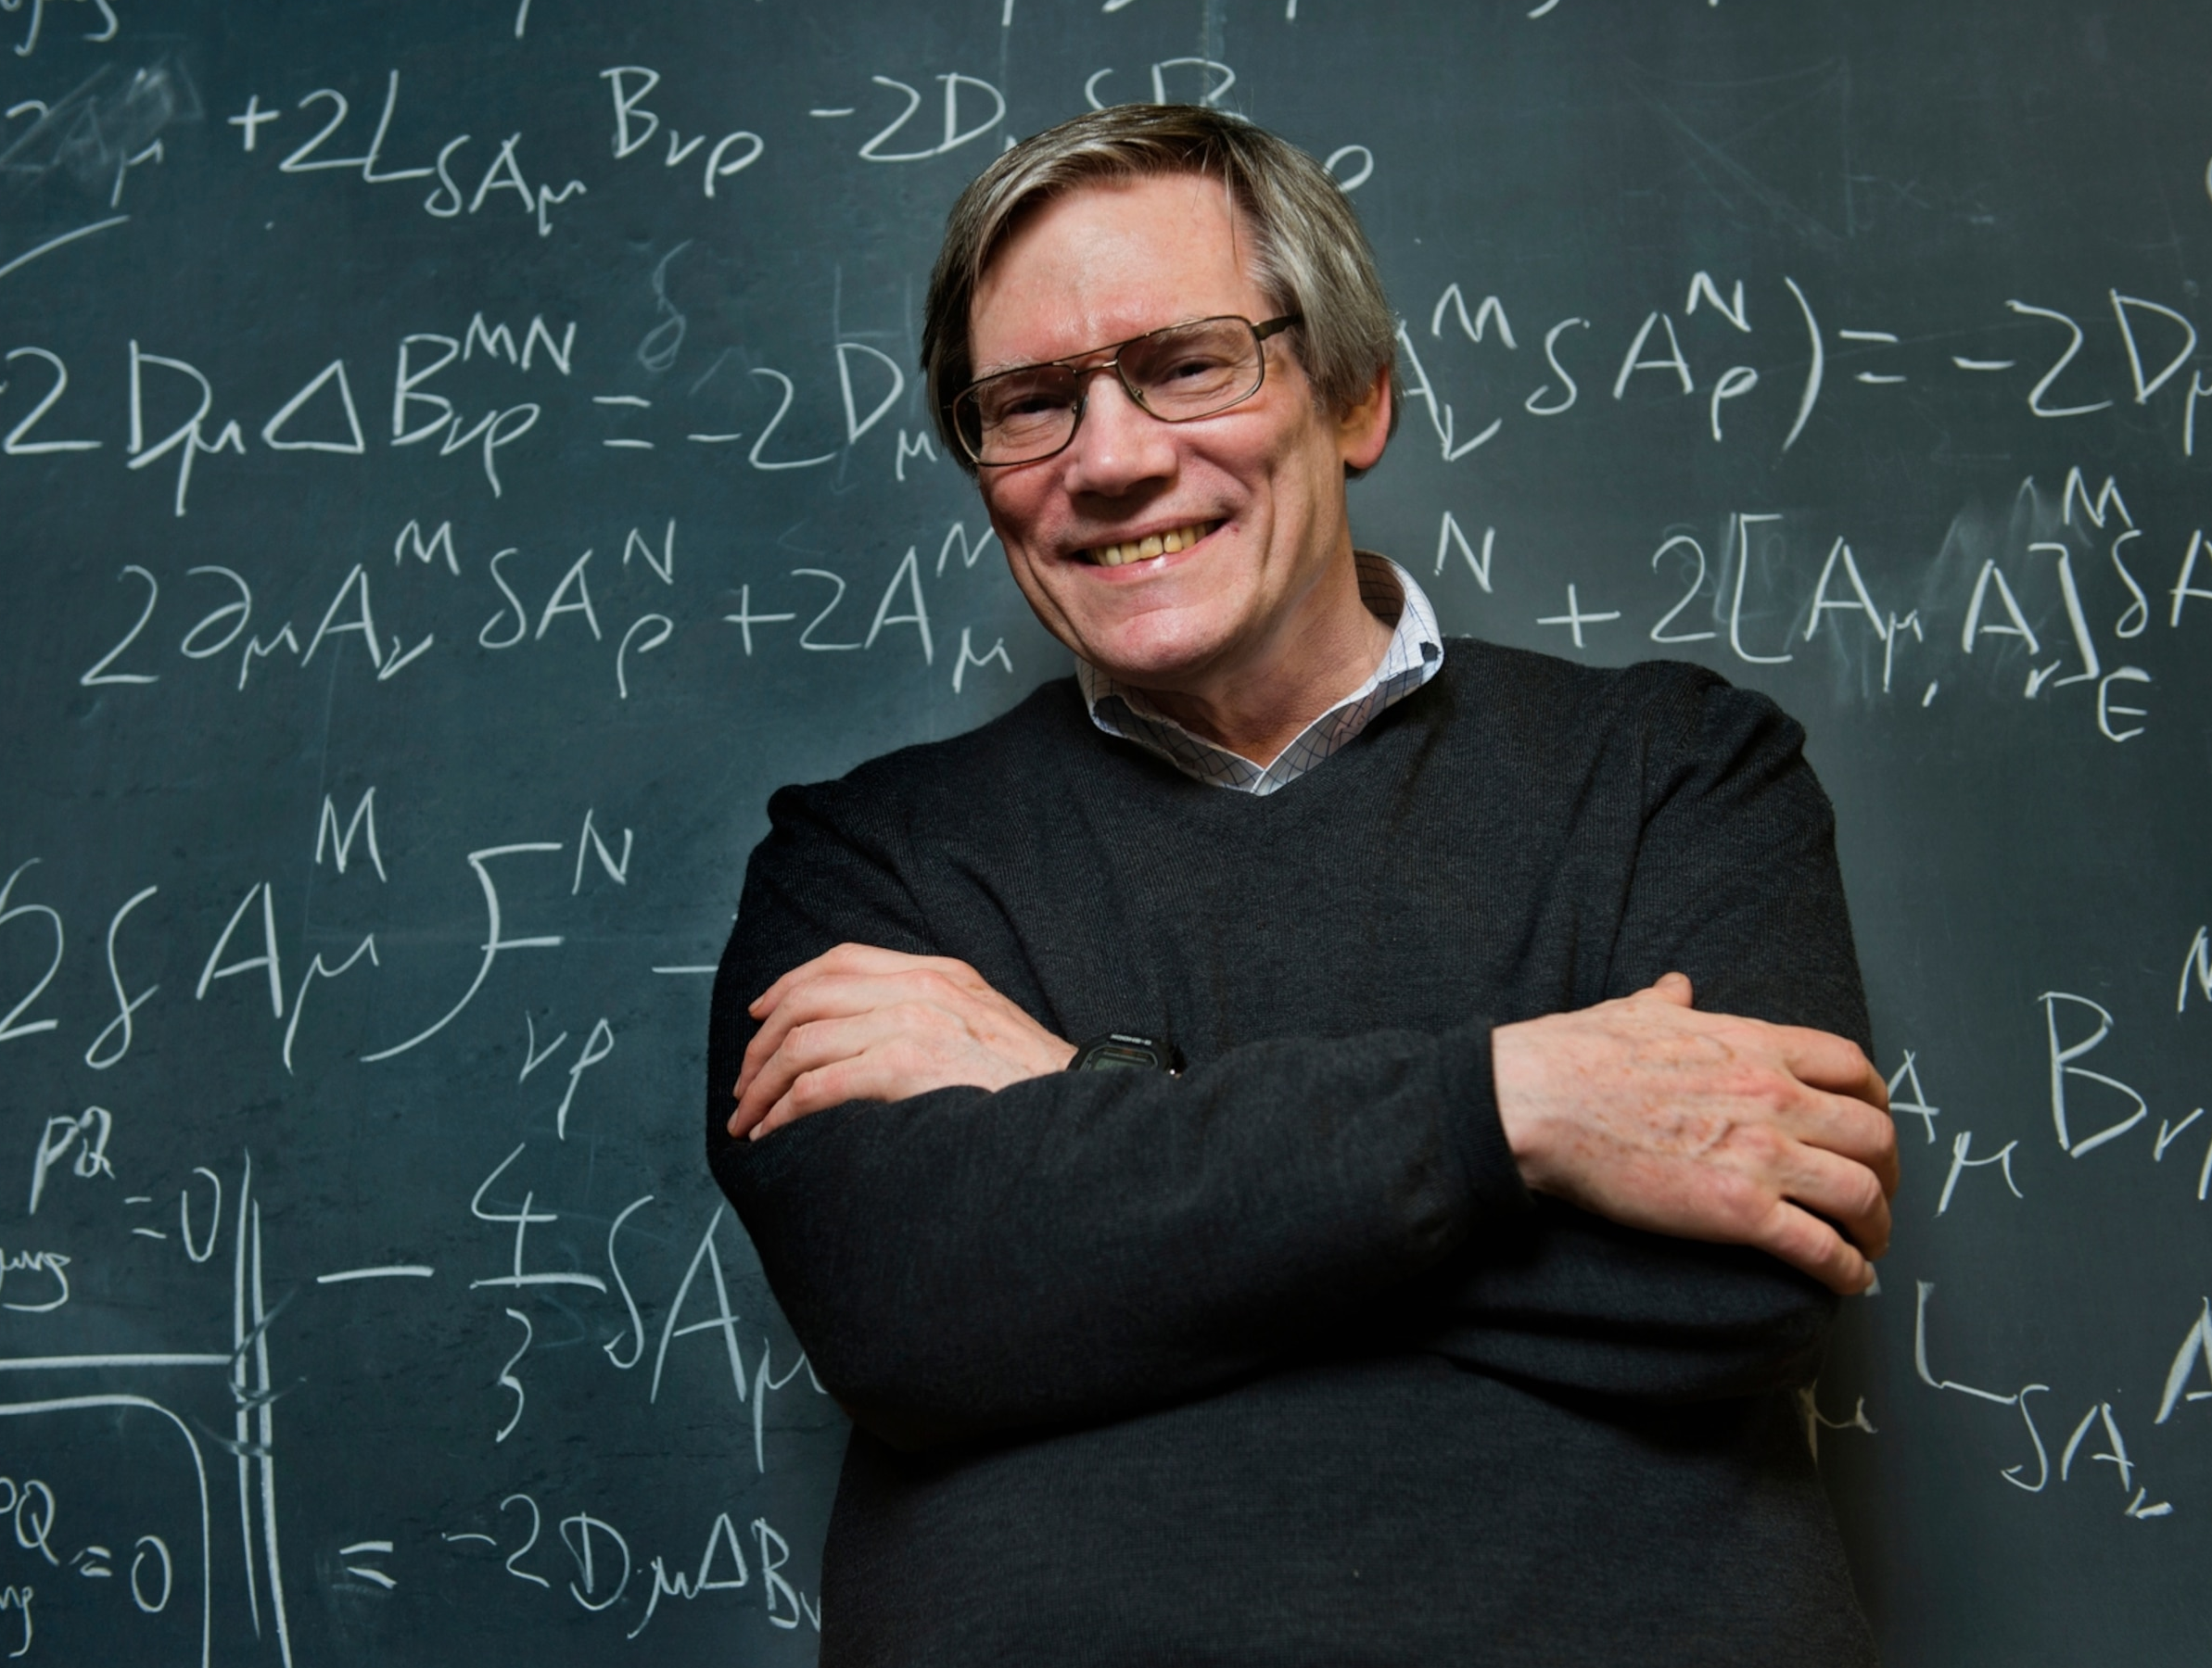
Possibility of the creation of the universe?
Roger Penrose (Penrose number): The Penrose number is a concept introduced by physicist Roger Penrose to describe the incredibly low probability of the universe's initial conditions being as they are. Penrose proposed that the odds of the universe having its current low-entropy state at the Big Bang are about 10⁽¹⁰⁾²³ ⁼
1 followed by 300 zeros: 1,000,000,000,000,000,000,000,000,000,000,000,000,000,000,000,000,000,000,000,000,000,000,000,000,000,000,000,000,000,000,000,000,000,000,000,000,000,000,000,000,000,000,000,000,000,000,000,000,000,000,000,000,000,000,000,000,000,000,000,000,000,000,000,000,000,000,000,000,000,000,000,000,000,000,000,000,000,000,000,000,000,000,000,000,000,000
Lee Smolin: Smolin has calculated that the odds of life-compatible numbers coming up by chance is 1 in 10^229. He discusses this in the context of the fine-tuning of physics for life
1 followed by 229 zeros: 1,000,000,000,000,000,000,000,000,000,000,000,000,000,000,000,000,000,000,000,000,000,000,000,000,000,000,000,000,000,000,000,000,000,000,000,000,000,000,000,000,000,000,000,000,000,000,000,000,000,000,000,000,000,000,000,000,000,000,000,000,000,000,000,000,000,000,000,000,000,000,000,000,000,000,000,000,000,000
Alan Guth: Guth, known for his work on inflationary theory, has also considered the fine-tuning of the universe and the low probability of its initial conditions
Roger Penrose: British mathematician
Lee Smolin: American physicist
Alan Guth: American physicist and cosmologist

Slide 31
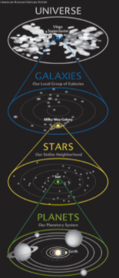
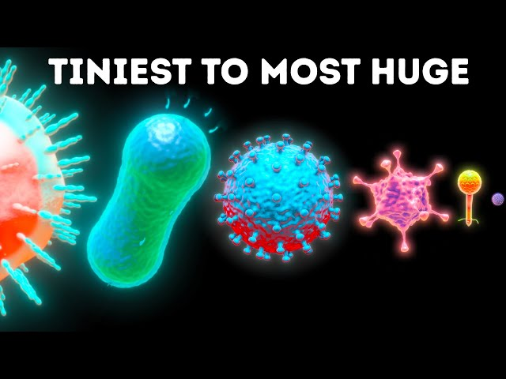
The space we occupy in the entire universe?
The diameter of the observable universe is about 93 billion light years. (One light year is 9.46 trillion kilometers)
To give you a better perspective, if you were to scale down the entire observable universe to the size of Earth, the region we occupy would be smaller than the tiniest bacterium. Our solar system, with all its planets and the Sun, would fit inside this bacterium.
Our solar system compared Universe
Size of bacteria

Slide 32
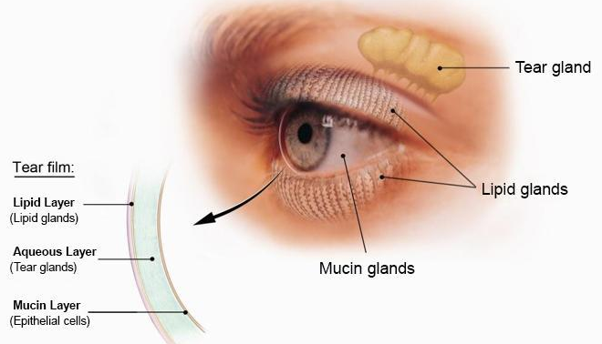
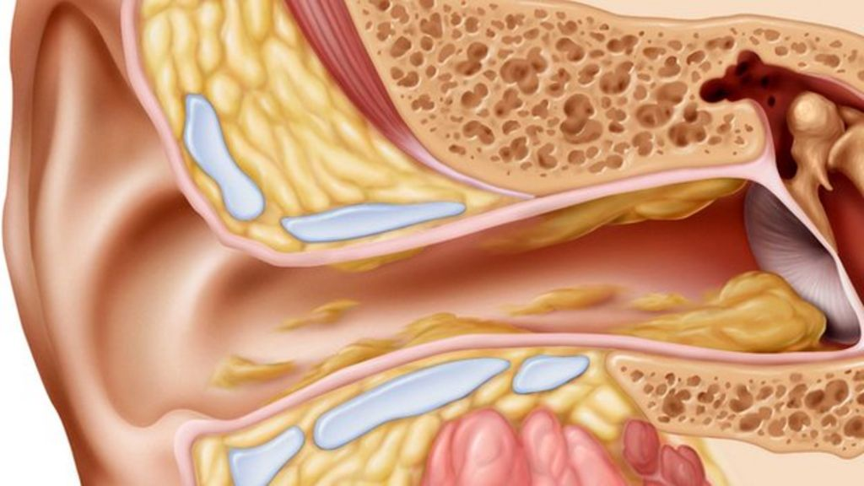
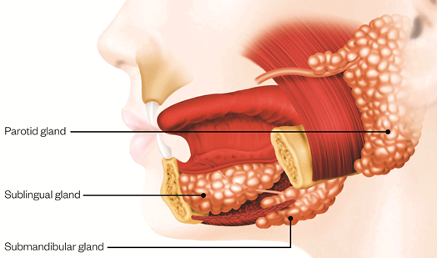
Unique Tastes and Functions of Fluids in the Human Head?
Eyes: Produce a salty fluid (tears) that cleans and keeps the eyes moist
Ears: Contain earwax, which has a bitter or unpleasant taste, and helps clean the ears and protect against the insects.
Mouth: Produces neutral-tasting saliva which aid in tasting food and digestion.

Slide 33
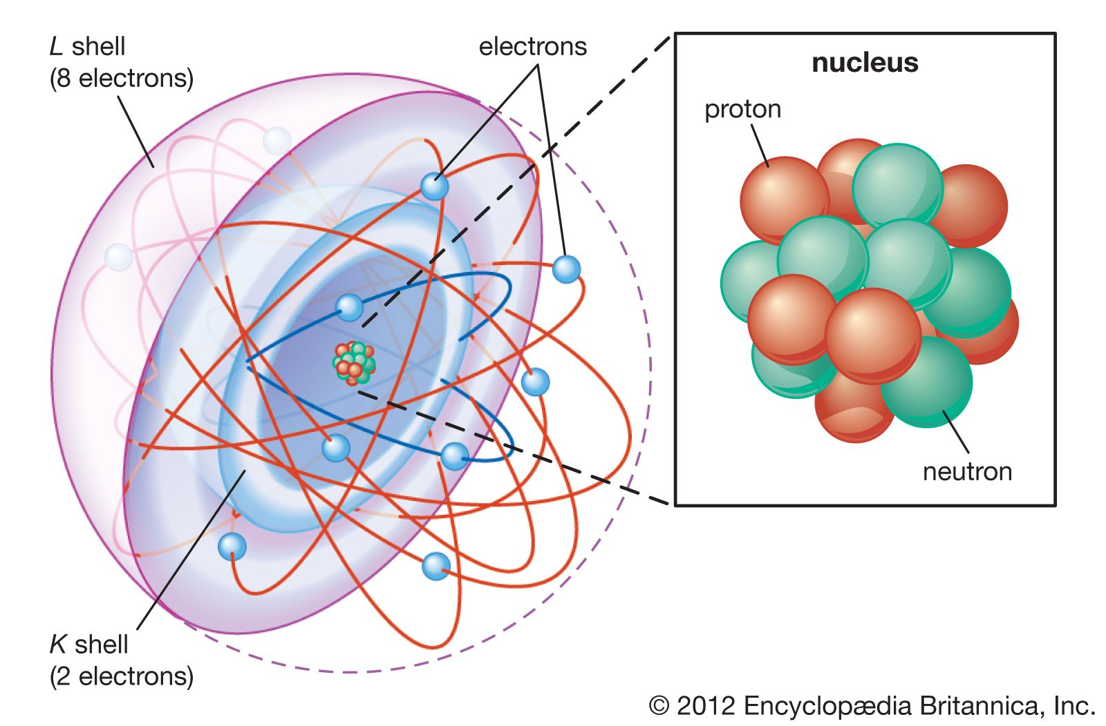
Atoms and Consciousness?
No Mind or Consciousness:
Atoms do not possess consciousness or awareness. They are composed of subatomic particles (protons, neutrons, and electrons) and interact based on fundamental forces such as electromagnetism.
No Decision-Making Abilities:
Atoms and their interactions are determined by physical laws. They do not have the capability to make decisions or exhibit free will. Their behavior is predictable based on scientific principles.
Role in Larger Systems:
While individual atoms do not think, when they come together to form complex systems, such as molecules, cells, and ultimately brains, they participate in processes that give rise to thinking and consciousness. However, this is an emergent property of the complex system, not of the individual atoms.

Slide 34
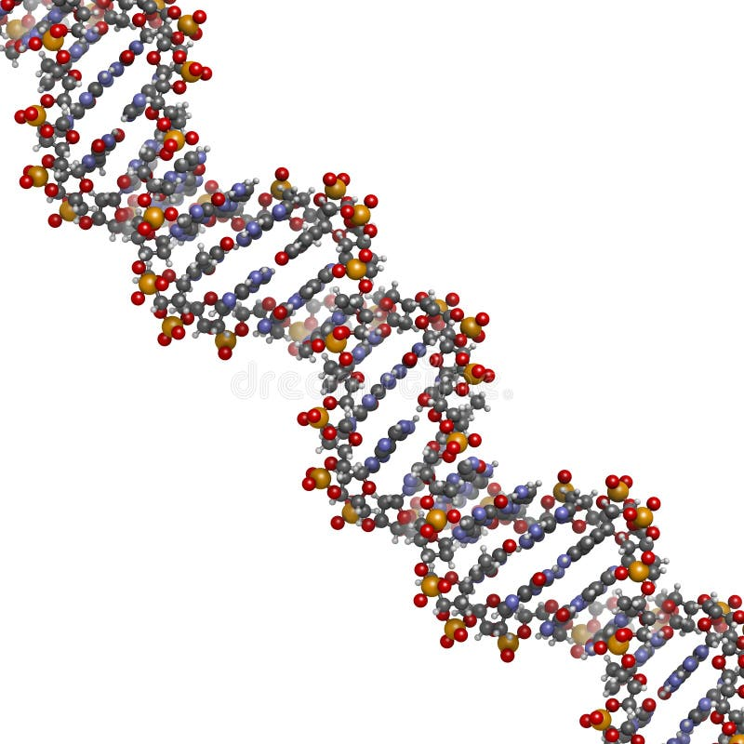
DNA?
The Blueprint of Life
What is DNA?: DNA is a molecule that carries the instructions needed for an organism to grow, function, and reproduce.
Structure: It looks like a twisted ladder, called a double helix. Each rung is made of pairs of chemicals called bases.
Function: DNA stores all the genetic information needed to make proteins, which do most of the work in our bodies. DNA carries genetic information crucial for the growth, functioning, and reproduction of living organisms.
DNA Composition
Atoms: DNA consists of carbon, hydrogen, oxygen, nitrogen, and phosphorus atoms.
Structure: These atoms form the building blocks of nucleotides, which make up the DNA molecule.
The Recipe Book
DNA as a Cookbook: Think of DNA as a big recipe book that contains all the recipes for making you. Each recipe is for a different part of your body.
Genes as Recipes: Each gene is like a single recipe in the book. Some recipes are for making your eyes, others for your hair, and so on.
Nucleotides as Ingredients: The nucleotides (A, T, C, G) are like the ingredients listed in each recipe. They need to be in the right order to make everything work properly.

Slide 35
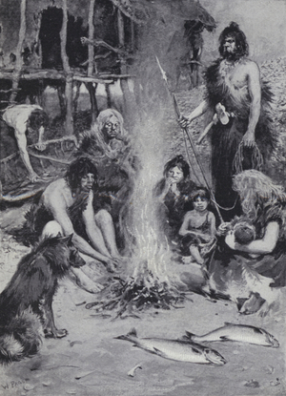
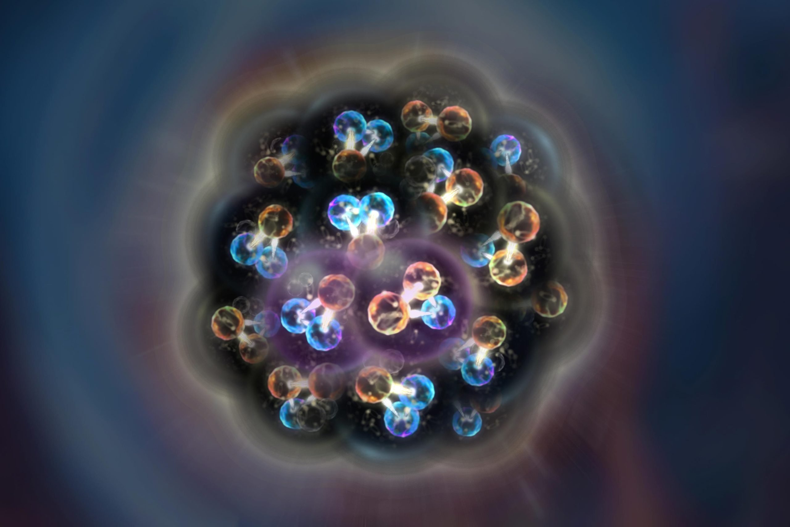
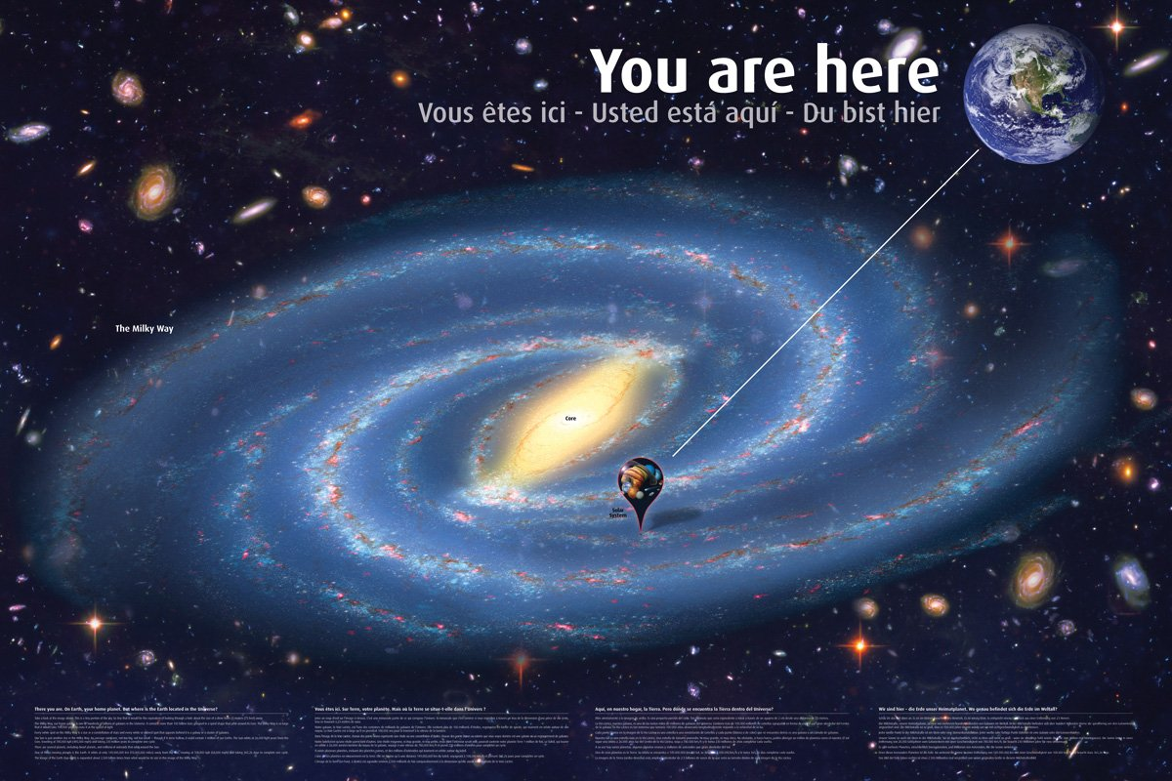
Big-Bang?
NASA: "The origin, evolution, and nature of the universe have fascinated and confounded humankind for centuries. New ideas and major discoveries made during the 20th century transformed cosmology – the term for the way we conceptualize and study the universe – although much remains unknown."
What We Know:
The Big Bang Theory describes the universe's rapid expansion from a hot, dense state.
Fundamental Particles: Initially, the universe was filled with high-energy particles such as quarks, electrons, and gluons.
Energy: The universe started with an immense amount of energy in a very small space.
Quarks, electrons, and gluons, like atoms, do not have minds, the ability to think, or the capacity to make choices. They are fundamental particles that follow the laws of physics without any form of consciousness or decision-making abilities
Scientists do not yet know what caused the Big Bang. Various hypotheses include:
Quantum Fluctuations: Random fluctuations in a quantum vacuum.
Cosmic Inflation: A rapid expansion phase from a high-energy state.
Brane Collisions: Interactions in higher-dimensional space (string theory).
Boum!
Paf!
https://science.nasa.gov/universe/the-big-bang/

Slide 36

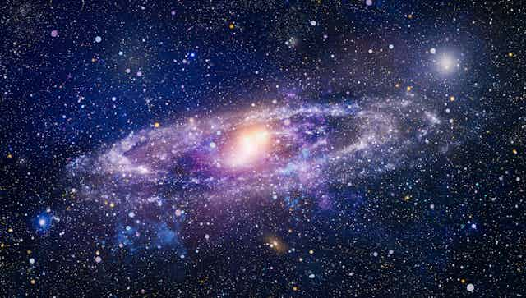
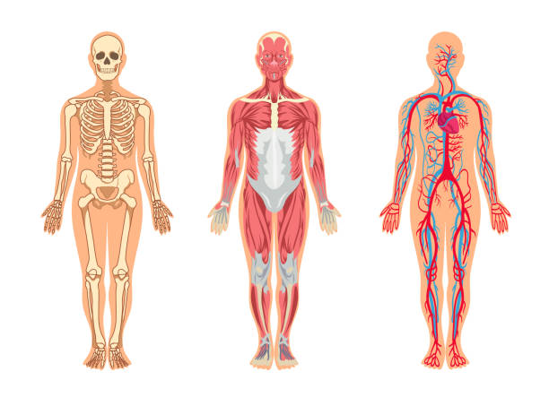

Discovering the art does not prove that the artist does not exist

Slide 37
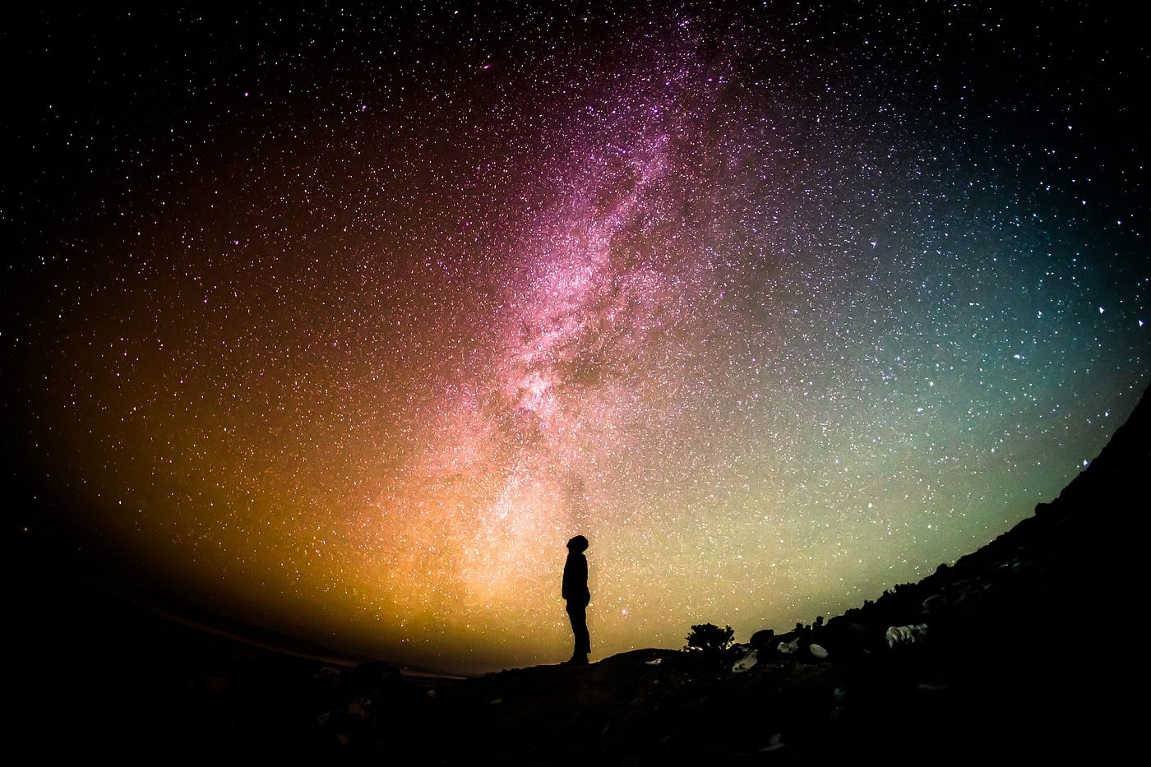
Looking for Higher Power?
Research by University of Oxford:
Project: The Cognition, Religion, and Theology Project
Finding: Humans have natural tendencies to believe in gods and an afterlife
Studies: Conducted over 40 studies in 20 different countries
Conclusion: Beliefs in gods and an afterlife are part of human nature, not just taught
Led by:
Dr. Justin Barrett
Professor Roger Trigg
Involved researchers from anthropology, psychology, philosophy, and theology
The Gospel of the Redman (Book)
Author: Ernest Thompson Seton (Christian)
Overview:
Explores the spiritual beliefs, customs, and way of life of Native Americans (without communication with other people).
Aims to preserve and share the wisdom and teachings of indigenous people and their believes.

Slide 38

Corruption of the Bible?
Bible: "Bible is the word of God"
A contradiction occurs when two or more statements or ideas are in direct opposition to each other, making them impossible to both be true at the same time. Eg.:
In reality: person 'A' dressed in Green
Person 'B' says: Person 'A' was dressed in Black
Person 'C' says: Person 'A' was dressed in Green
If a contradiction arises from deliberately misleading information or attempts to deceive, then it can indicate corruption or dishonesty.
Some contradictions:
Quantity of enemies:
2 Samuel 23-8: These be the names of the mighty men whom David had: The Tachmonite that sat in the seat, chief among the captains; the same was Adino the Eznite: he lift up his spear against eight hundred, whom he slew at one time.
1 chronicles 11-11: Jashobeam, a Hakmonite, was chief of the officers; he raised his spear against three hundred men, whom he killed in one encounter.
The father's name of Joseph:
Matthew 1-16: And Jacob begat (an old term for "became the father of) Joseph the husband of Mary, of whom was born Jesus, who is called Christ...
Luke 3-23: Now Jesus himself was about thirty years old when he began his ministry. He was the son, so it was thought, of Joseph, the son of Heli...
Age:
2 Chronicles 22-2 (KJV): Forty and two years old was Ahaziah when he began to reign, and he reigned one year in Jerusalem. His mother's name also was Athaliah the daughter of Omri.
2 Kings 8-26 (KJV): Two and twenty years old was Ahaziah when he began to reign; and he reigned one year in Jerusalem. And his mother's name was Athaliah, the daughter of Omri king of Israel.
Did Michal had children or not?:
2 Samuel 6:23: And Michal daughter of Saul had no children to the day of her death.
2 Samuel 21:8: But the king took the two sons of Rizpah the daughter of Aiah, whom she bare unto Saul, Armoni and Mephibosheth; and the five sons of Michal the daughter of Saul, whom she brought up for Adriel the son of Barzillai the Meholathite

Slide 39
Jesus was not a God?
Attributes of God?
 | God | Jesus | Other prophets
Eat, drink, sleep | No | Yes | Yes
Need help | No | Yes | Yes
Pray | No | Yes | Yes
Is high power | Yes | No | No
Miracle | Gives it | Use it | Use it
Trinity?
Early Church Fathers found the Trinity: Thinkers like Tertullian (who first used the term "Trinity"), Origen, and Athanasius played pivotal roles in shaping Trinitarian theology.
In bible: While Jesus spoke of the Father and the Spirit, he did not explicitly lay out the doctrine of the Trinity.

Slide 40
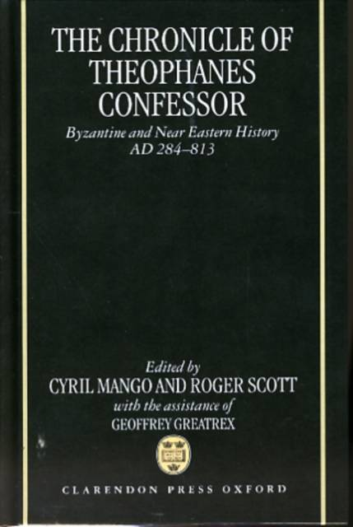
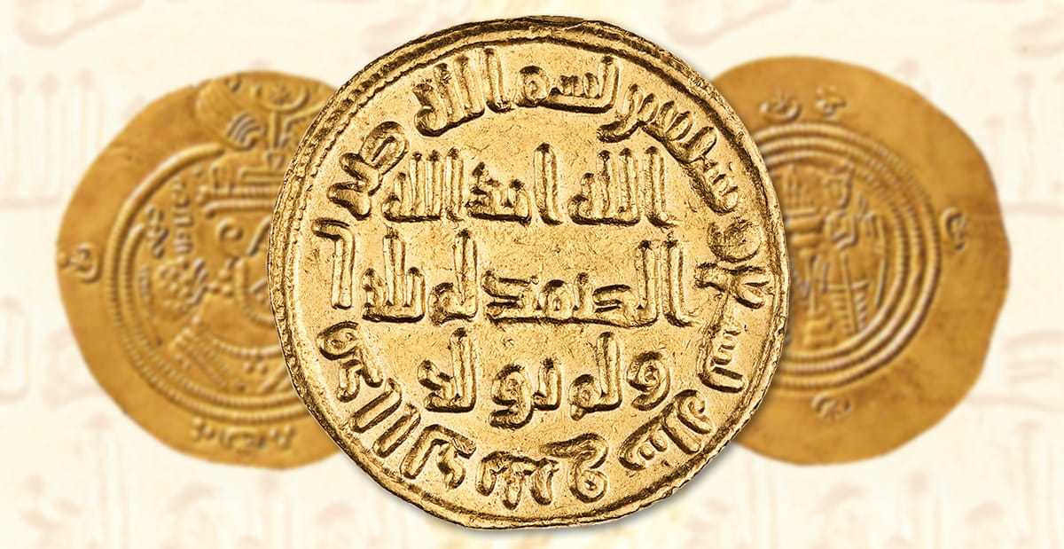
Muhammed (saw) existed in history?
Islamic Sources:
Qur'an: While the Qur'an itself is primarily a religious text, it contains references to events and figures in Muhammad (saw) life.
Sīrah: These are biographies of Muhammad's life, written by early Muslim historians such as Ibn Ishaq and Ibn Hisham.
Hadith: Collections of sayings and actions of Muhammad (saw), compiled by scholars like Bukhari and Muslim.
Non-Muslim Sources:
Byzantine and Syriac Chronicles: Some early Christian sources mention Muhammad (saw), often in a negative light, but they confirm his existence.
Coins and Inscriptions: Coins from the early Islamic period and inscriptions mention Muhammad, providing tangible historical evidence.
Historical Accounts: Works by historians such as al-Tabari and al-Baladhuri provide detailed accounts of Muhammad (saw) life and the early Islamic community.

Slide 41

Islam is absolutely the right way and the religion of truth?
Question yourself with those:
Do you believe that the univers, atoms & earth is created/programmed by a Creator? (if not -> Facts)
Do you believe that Creator communicates with us with Qur'an? (if not -> Science in Qur’an)
Do you believe that Prophet Muhammed (saw) existed and is the last prophet? (if not -> Existed & Last Prophet)
If you believe all those above:
Take your Shahada brother and welcome in Islam

Slide 42
FAQ
Do we need Religion? (Morality)
Do we need Religion? (Curiosity)
Do we need Religion? (Spiritual)
Why did Allah (cc) created us?
Why is there evil in the earth?
Is it allowed to kill civils as Muslim?
Why do Muslim women wear hijab?
Why can't Muslims eat pork or drink alcohol?
Why is there violence associated with Islam?
Role & rights of woman in Islam?
Men and Women comparison?
Multiple wives?
Why praying 5 times daily?
Is there afterlife?
Can you tell me how we should see time? (Timeline)
Marriage age of Aicha (ra)?

Slide 43




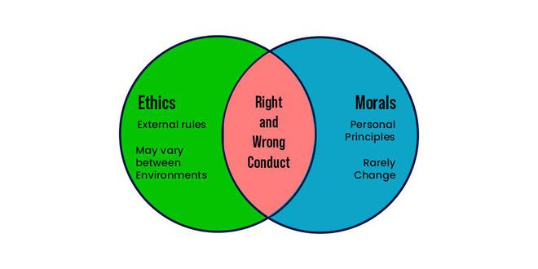
Do we need Religion?
Principle of religion is to give us a sense of right and wrong, and help us to be 'good'.
Murderer
Drug dealer
Child rapist
Alcoholic
For each one from above they may find okey to perform their actions.
Who defines, who did correct or wrong action? Who defines what is morally or etically correct actions?
Who defines my ethics?
Objective: is based on facts.
Subjective or a subjective perspective: is based on opinion, emotion, or feelings

Slide 44

Do we need Religion?
Curiosity: "a strong desire to know or learn something."
Let's test something:
Give 3 cities you want to visit:
Give 3 car modals you want to have:
Give 3 receipts you want taste:
Would you accept to go those cities -> without having eyes? Would you accept to drive those cars -> without having one leg? Would you accept to taste those receipts -> without having the taste buds on your tongue?
The oxygene, rain, arms, legs, the sun, fruits, eyes, moon, trees, plants, galaxy, earth, blood, thinking, feeling, sensing, snow, univers, Etc. Etc. Who, for what reason gives you these?

Slide 45
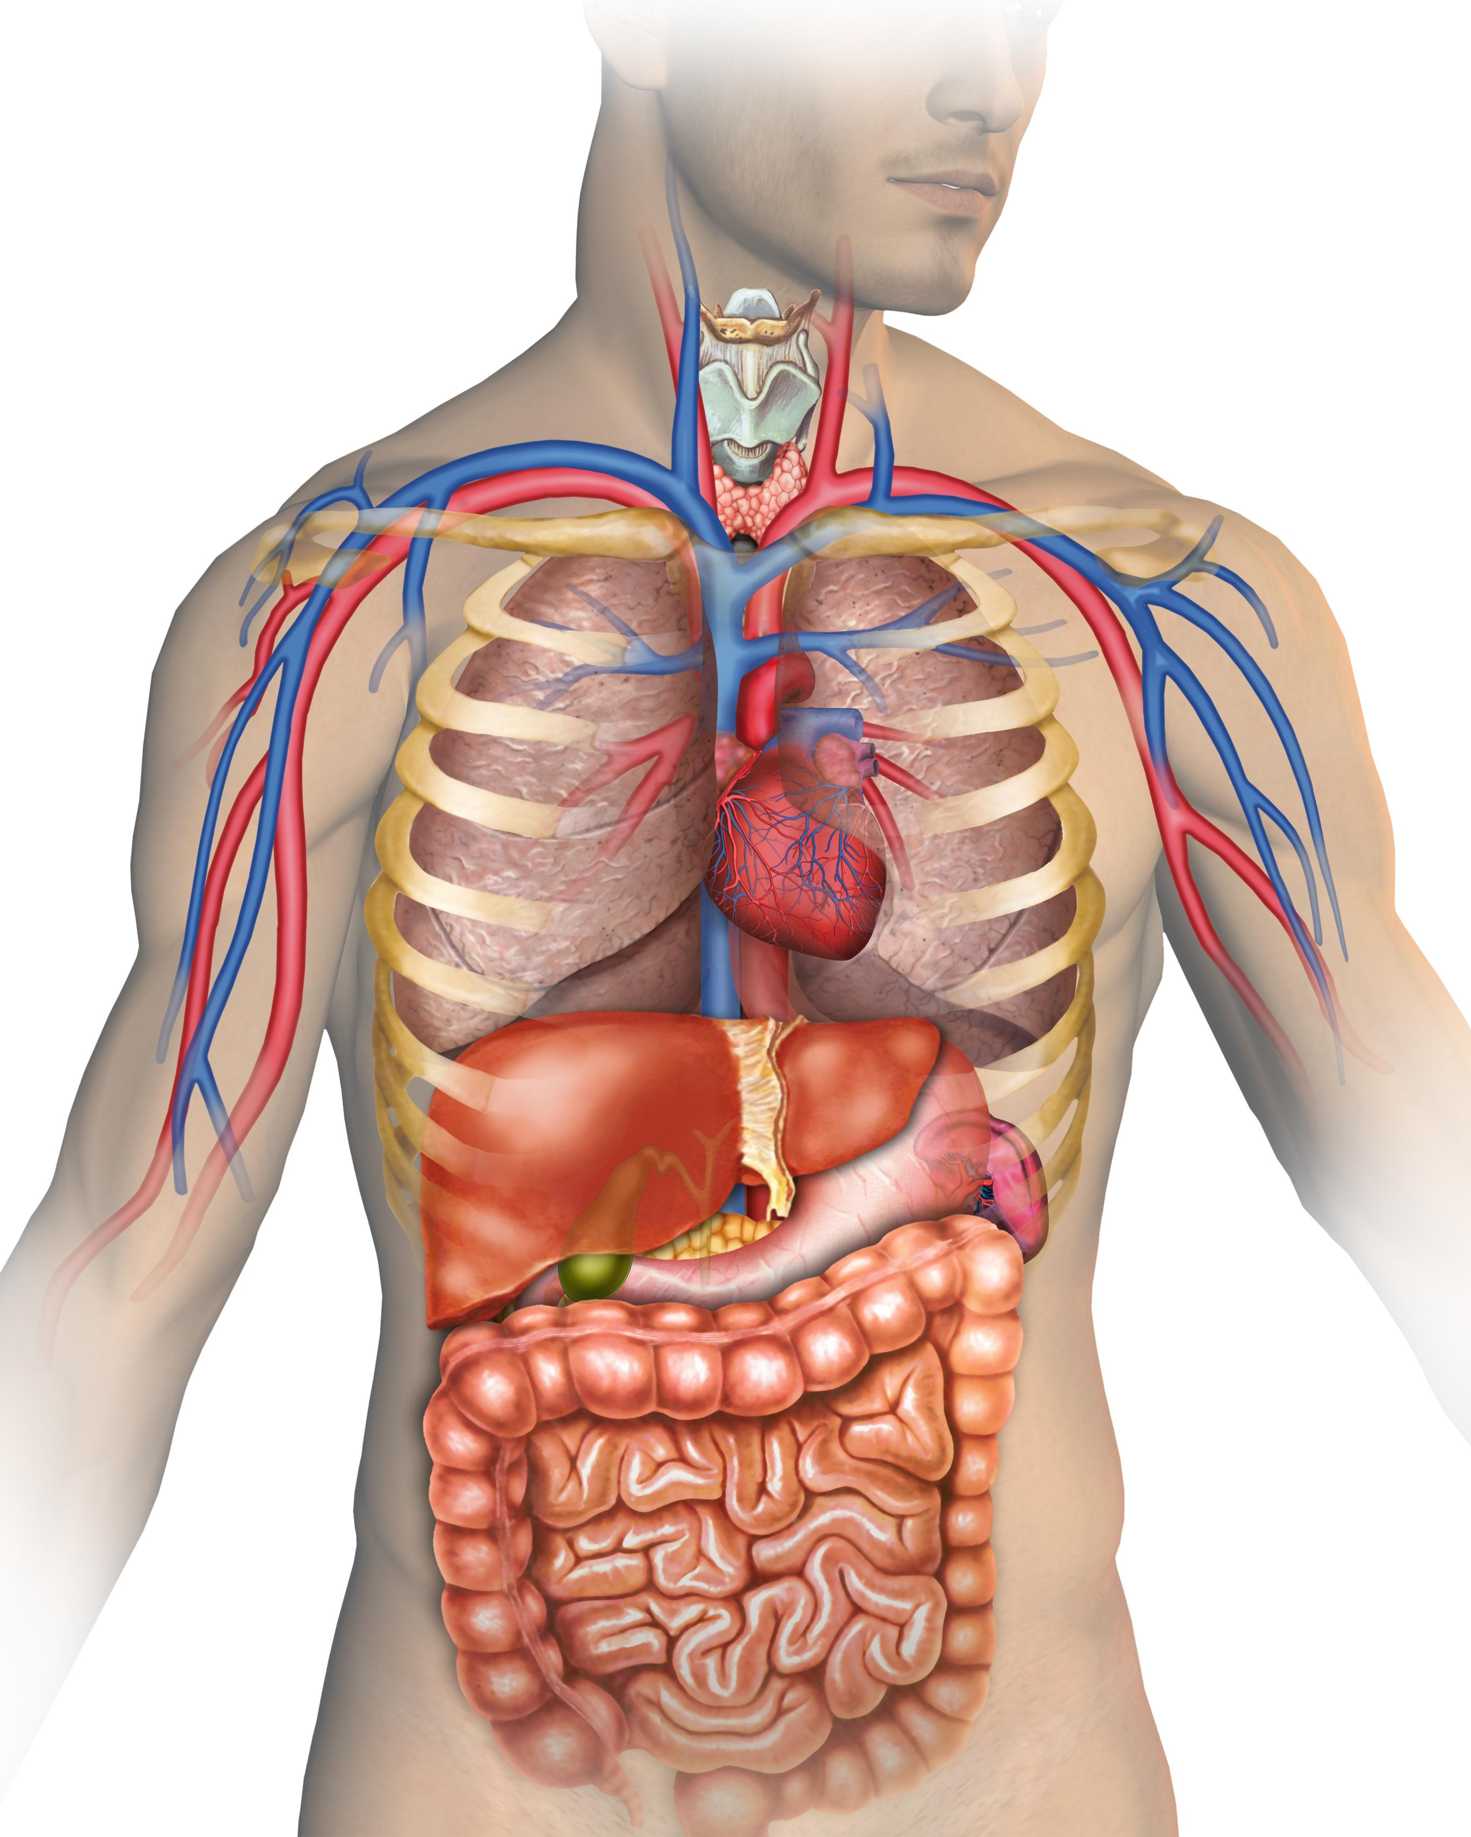
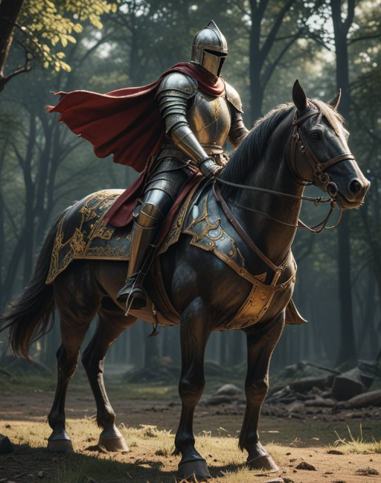
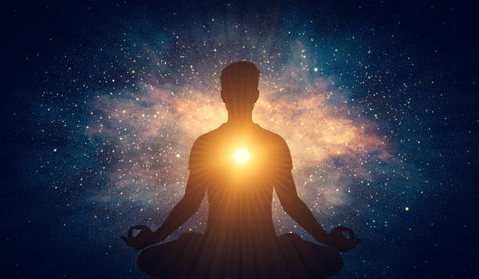
Do we need Religion?
Spirituality: "Spirituality involves the recognition of a feeling or sense or belief that there is something greater than myself."
Personal Growth: Our journey in life is meant to develop our spiritual and moral character.
Metaphor: Imagine a knight and his horse preparing for battle. The knight represents the physical body, while the horse symbolizes the spiritual self. Just as a knight cannot effectively go to war without his horse, a person cannot live a fulfilling life without nurturing both their body and spirit. In Islam, spirituality involves practices such as prayer, remembrance of Allah (dhikr), and trust in Allah (tawakkul), which are essential for spiritual growth and maintaining a deep connection with the divine.

Slide 46
Why did Allah (cc) created us?
Primary Purpose: In Islam, the primary reason for our creation is to worship and serve Allah (cc)
(Qur'an 51:56):
"And I did not create the jinn and mankind except to worship Me."
This means that our existence is meant to be in constant remembrance and devotion to Allah, acknowledging His greatness and following His guidance.
Life as a Test: Life is viewed as a test in which our actions, intentions, and faith are evaluated.
(Qur'an 67:2):
"He who created death and life to test you [as to] which of you is best in deed."
Recognizing Allah’s Blessings: By experiencing life, we can appreciate the blessings and mercy of Allah.
Living in this world allows us to experience its beauty and challenges, which in turn fosters gratitude towards Allah.
Briefly: It is to know/find Allah (cc), to serve Him, to live in accordance with human and moral values and to prepare for eternal life.

Slide 47

Why is there evil in the earth?
Free Will:
In Islam, humans are given free will to make their own choices. This freedom allows people to choose between good and evil.
Just as a person can choose to do good, they can also choose to do harm. The existence of free will means that people are responsible for their actions.
Test and Trial:
Life is seen as a test in which individuals are tested through various challenges, including the presence of evil.
These tests are opportunities for people to demonstrate their faith, patience, and resilience.
Dichotomy:
A division or contrast between two things that are presented as opposites or entirely different.
Black & White: Represents the dichotomy of color extremes.
Good & Evil: Represents the moral dichotomy.
Masculine & Feminine: Represents the gender dichotomy.
Big & Small: Represents the size dichotomy.
Young & Old: Represents the age dichotomy.

Slide 48
Is it allowed to kill civils as Muslim?
Surah Al-Isra (17:33):
"And do not kill the soul which Allah has forbidden, except by right. And whoever is killed unjustly - We have given his heir authority, but let him not exceed limits in [the matter of] taking life. Indeed, he has been supported [by the law]."
Surah An-Nisa (4:93):
"But whoever kills a believer intentionally - his recompense is Hell, wherein he will abide eternally, and Allah has become angry with him and has cursed him and has prepared for him a great punishment."
Surah Al-Baqarah (2:190):
"Fight in the way of Allah those who fight you but do not transgress. Indeed. Allah does not like transgressors."
Surah Al-Ma'idah (5:32):
"Because of that, We decreed upon the Children of Israel that whoever kills a soul unless for a soul or for corruption [done] in the land - it is as if he had slain mankind entirely. And whoever saves one - it is as if he had saved mankind entirely."
Sunan Abu Dawud 2614: Narrated Anas ibn Malik, the Prophet (peace be upon him) said,
"Go in Allah's name, trusting in Allah, and adhering to the religion of Allah's Apostle. Do not kill a decrepit old man, or a young infant, or a child, or a woman; do not be dishonest about booty, but collect your spoils, do right and act justly."

Slide 49

Why do Muslim women wear hijab?
Difference between Men & Women:
Physical Differences:
Men are seen stronger
Women are seen vulnerable, beautiful and fragile
Mentally Differences:
Men are seen decisive and protective
Women are seen emotional, nurturing and empathetic
The Pearl in the Shell Metaphor
Imagine a beautiful pearl inside a shell. The shell protects the pearl from harm, keeping it safe and preserving its beauty. The hijab can be seen as the shell, and the woman as the precious pearl inside. Just as the shell safeguards the pearl, the hijab provides protection and preserves the dignity and modesty of the woman.
Protection: Just as the shell protects the pearl from external damage, the hijab protects a woman from unwanted attention and objectification.
Value and Dignity: The pearl is valuable and precious, and the shell signifies its worth. Similarly, the hijab signifies the value and dignity of the woman, emphasizing her inner qualities over her physical appearance.

Slide 50


Why can't Muslims eat pork or drink alcohol?
Islamic Perspective on Pork and Alcohol
Pork: Prohibited in the Qur'an (Surah Al-Baqarah 2:173; Surah Al-Ma'idah 5:3) as it is considered impure.
Alcohol: Forbidden in the Qur'an (Surah Al-Ma'idah 5:90-91) due to its harmful effects and its role in leading to sinful behavior.
Scientific Perspective
Pork: High in fat and cholesterol, potentially leading to heart disease. Pork can also carry parasites like Trichinella, which cause serious illness.
Alcohol: Linked to liver disease, addiction, impaired judgment, and other health issues. It affects mental and physical health adversely.

Slide 51

Why is there violence associated with Islam?
Core Teachings: Islam emphasizes peace, compassion, and justice. For example, the Qur'an states that saving a life is like saving all of humanity (Surah Al-Ma'idah 5:32).
Misinterpretation: A minority misuse Islamic teachings to justify violence, which is contrary to the religion's core principles.
Broader Factors: Many instances of violence are driven by political, social, and economic issues, not religion alone. (Effected by Media)
Condemnation: Muslim leaders globally condemn violence and terrorism, advocating for peace and dialogue.

Slide 52
Role & rights of woman in Islam?
Roles of Women in Islam
Spiritual Equality: Men and women are spiritually equal (Qur'an 33:35).
Family Role: Key role as caregivers and nurturers. "Paradise lies at the feet of your mother" (Hadith, Sunan an-Nasa'i).
Social Role: Encouraged to seek knowledge and participate in community activities. “Seeking knowledge is obligatory upon every Muslim, male and female” (Hadith, Sunan Ibn Majah).
Rights of Women in Islam
Education: Equal right to education. “Seeking knowledge is obligatory upon every Muslim, male and female” (Hadith, Sunan Ibn Majah).
Economic Rights: Right to own property, work, and earn money. (Qur'an 4:7).
Marriage and Family: Right to choose a spouse and seek divorce. (Qur'an 2:232).
Inheritance: Entitled to a share of inheritance. (Shouldn't share her inheritance with his man) (Qur'an 4:11).
Protection and Dignity
Respect and Honor: Abuse and mistreatment are condemned. (Qur'an 4:19).
Legal Rights: Right to fair treatment and legal participation. “When women seek your counsel, treat them with kindness and respect” (Hadith, Sahih Bukhari).

Slide 53


Men and Women comparison?
Provider: Men are typically responsible for providing financial support for their family. “Men are the protectors and maintainers of women, because Allah has given the one more (strength) than the other, and because they support them from their means” (Qur'an 4:34).
Protector: Men are expected to ensure the safety and well-being of their family members.
Leadership: Men often take leadership roles within the community & family.
Sharing Wealth: Men are obligated to share their earnings with their family, ensuring their needs are met.
Military Service: Men are expected to defend their community (country) may be called upon to participate in military service (or in war).
Modesty: Men are required to cover their body from the navel to the knees. Men should avoid wearing tight or revealing clothing that draws unnecessary attention. Men are prohibited from wearing gold jewelry. Men are also prohibited from wearing pure silk.
Inheritance: Men typically receive a larger share of inheritance to reflect their financial responsibilities. “To the male, a portion equal to that of two females” (Qur'an 4:11).
Pay the Mahr: Men are required to provide a mahr to their wives. "And give the women [upon marriage] their [bridal] gifts graciously..." (Qur'an 4:4).
Caregiver: Women are seen as the primary caregivers, responsible for the nurturing and upbringing of children.
Household Manager: Women oversee household responsibilities and ensure a harmonious home environment.
Education: Women are encouraged to seek knowledge and educate their children.
Financial Independence: Women are entitled to keep their earnings and wealth for themselves and are not required to share it with their husband. “And for women is a share of what the parents and close relatives leave” (Qur'an 4:7).
Modesty: Women are required to cover their entire body except for the face and hands. “And tell the believing women to lower their gaze and guard their chastity, and not to reveal their adornments except what normally appears” (Qur'an 24:31). Women should avoid wearing tight or revealing clothing. Many choose to wear the hijab as a sign of modesty and faith.
Inheritance: Women receive a share of inheritance, typically half of what men receive, reflecting their roles and financial responsibilities.
No Financial Obligation for Marriage: Women are not required to pay any part of the marriage expenses or the mahr.
After this comparison, who do you think has more obligations?

Slide 54
Multiple wives?
"Most countries have a female share of the population between 49 and 51 percent " - Our World In Data
Question:
Let's say the ratio of women is approximately 55% worldwide (without considering war; in times of war, this ratio may increase). If we distribute this ratio, giving each man (45%) a woman (55% - 45%), what happens with the remaining 10% of women?
Fıtrat (innate nature of humans, in Turkish)
Fıtrat of Men & Women in Relation
Polygamy: In Islam, a man is permitted to marry multiple women (up to four) but cannot accept a woman who has multiple husbands. This aligns with the natural disposition (fitrat) that Allah has instilled in human beings.
Monogamy: Women generally seek protection, attention, and love from a single man. Most women do not accept a second wife due to feelings of jealousy, although some do.
Natural Balance: The Creator, Allah (cc), understands the inherent nature (fitrat) of men and women. He has designed roles and relationships to ensure harmony and balance within society.
Answer to the Question (Perpesctive of Islam):
Given the hypothetical scenario where women make up 55% of the population, and men make up 45%, with each man being paired with one woman:
The remaining 10% of women could potentially become second, third, or fourth wives to men, as permitted in Islam. This approach ensures that all women have the opportunity to be part of a family and receive the protection, attention, and love that align with their natural disposition.
This arrangement reflects the wisdom of the Creator, Allah (cc), in understanding the natural tendencies and needs of both men and women, ensuring social harmony and stability.
Obligations Set by Allah (cc) before marrying multiple wives:
Justice and Fairness:
A man must treat all his wives fairly and justly. This includes providing equal financial support, time, and attention to each wife.
Respect and Dignity:
A man must respect and honor all his wives, ensuring their dignity and well-being.
Marriage Contract Conditions:
Women can include conditions in their marriage contract, such as the husband not marrying another wife without her consent.
https://ourworldindata.org/gender-ratio

Slide 55
Why praying 5 times daily?
Purpose of praying: To glorify the Almighty (Tesbih = SubhanAllah, Alhamdulillah, Allahu Akbar)
SubhanAllah: "Glory be to Allah" (= You have no limitations, flaws, weaknesses)
Alhamdulillah: "All praise is due to Allah." (= I thank/praise/glorify You for everything you've given me)
Allahu Akbar: "Allah is the Greatest" (= You are the greatest)
Qur’anic Verses on Prayer Obligation:
Surah Al-Baqarah (2:43): "Establish prayer and give zakah..."
Surah An-Nisa (4:103): "Indeed, prayer has been decreed upon the believers a decree of specified times."
Surah Al-Ma'idah (5:55): "Establish prayer and give zakah, and they bow [in worship]."
Surah Al-Mu’minun (23:1-2): "The believers who are during their prayer humbly submissive."
Surah Ankabut (29:45): "Establish prayer. Indeed, prayer prohibits immorality and wrongdoing."
Surah Al-Baqarah (2:110): "Establish prayer and give zakah..."
Praying 5 times daily, it is a way of proving yourself to Allah (swt) by saying: "My Lord, I am aware and I have not forgotten what You have given, what You are giving and what You will give me. You are One. My Lord, just You can forgive me and accept me to your Paradise."
Question:
If I give you 24 000 € each month and I ask 1 000 € each month back. Would you accept it or not?
Metaphoric: Story of Uncle
https://ourworldindata.org/gender-ratio

Slide 56

Is there afterlife?
1. Life After Death:
Temporary Life: Earthly life is a test for the eternal life to come.
2. Day of Judgment (Yawm al-Qiyamah):
Resurrection: All humans and jinn will be resurrected for judgment.
Qur’anic Verse: "And fear the Day when you will be returned to Allah..." (Surah Al-Baqarah, 2:281)
3. Heaven (Jannah) and Hell (Jahannam):
Reward and Punishment: Based on deeds, individuals enter eternal paradise (Jannah) or hell (Jahannam).
Qur’anic Verse: "Indeed, the righteous will be in pleasure..." (Surah Al-Mutaffifin, 83:22-24)

Slide 57
Can you tell me how we should see time?
Judgment
Soul realm
Life = Test
Tomb
Eternal life
Birth
Death
End of the world

Slide 58
Marriage age of Aicha (ra)?
Narrated by Aisha (ra): "The Prophet (saw) married me when I was six years old, and he consummated his marriage when I was nine years old. Hisham said: I have been informed that Aisha remained with the Prophet (saw) for nine years (i.e., until his death)." Hadith 5134 - Sahih al-Bukhari
In pre-Islamic Arabia, female infanticide was practiced in some tribes due to the preference for male children, they killed them often by burying newborn girls alive. The girls born in pre-Islamic Arabia counted their age from the moment of their menstruation. Which explains why Aicha (ra) says 6-9 years old. If she had her first menstruation at 9 years old, 9+9=18 years old she was married.
Aisha (RA) had an older sister named Asma bint Abi Bakr (ra). Asma was about 10 years older than Aisha “Asma passed away in the 73rd year of the Hijrah when she was one hundred years old. She was twenty-seven years old at the time of the Hijrah. Since Aisha was ten years younger than her sister, she would have been seventeen years old at the time of the Hijrah. In addition, Aisha was engaged to Jubayr before the Prophet. So she was a girl of marriageable age.” (Hatem al-Anbiya Hz. Muhammad and His Life, Ali Himmet Berki, Osman Keskioğlu, p. 210) We know that Prophet Muhammed (saw) married Aicha (ra) after Hijra.

Slide 59
Story of Uncle?
You have an uncle who lives far away. Although you've never met him in person, he sends you gifts regularly—daily, weekly, and monthly. These gifts bring you immense joy and make your life more enjoyable. Each time you receive a gift, you feel a wave of gratitude and happiness. This can be likened to the blessings and sustenance that Muslims receive from Allah throughout their lives.
Now, one day you receive a notification that your uncle is coming to visit. Overwhelmed with gratitude and excitement, you want to express your thankfulness in a meaningful way. You eagerly prepare to meet him at the airport, ensuring everything is perfect to show how much you appreciate his generosity. This represents the heightened sense of gratitude and devotion that Muslims feel towards Allah, especially during their five daily prayers.
Just as you would eagerly anticipate meeting your uncle and express your thanks, Muslims perform Salah to show their gratitude and devotion to Allah. Each prayer is a moment to acknowledge His blessings, seek His guidance, and strengthen the spiritual connection with Him. Through these prayers, Muslims demonstrate their profound thankfulness and reverence, much like you would for your uncle's kindness and generosity.
https://ourworldindata.org/gender-ratio

Slide 60

Questions

